Slide 1
Static Risk Sensitive RL
PhD Candidate: Jia Lin Hau
Advisor: Marek Petrik
Collaborators: Erick Delage, Esther Derman, Mohammad Ghavamzadeh

Slide 2
Content
Preliminaries
Markov Decision Processes (MDPs)
Motivation on Risk Measures
Prior Work on Risk Sensitive MDPs
Research and Contributions
Overview
Dynamic Program Decomposition
Entropic Based MDPs
Quantile Based MDPs

Slide 3
Content
Preliminaries
Markov Decision Processes (MDPs)
Motivation on Risk Measures
Prior Work on Risk Sensitive MDPs
Research and Contributions
Overview
Dynamic Program Decomposition
Entropic Based MDPs
Quantile Based MDPs
Publication:
On Dynamic Programming Decompositions of Static Risk Measures in Markov Decision Processes. Jia Lin Hau, Erick Delage, Marek Petrik, Mohammad Ghavamzadeh, NeurIPS 2023
Entropic Risk Optimization in Discounted MDPs. Jia Lin Hau, Marek Petrik, Mohammad Ghavamzadeh, AISTATS 2023
Q-learning for Quantile MDPs: A Decomposition, Performance, and Convergence Analysis. Jia Lin Hau, Erick Delage, Esther Derman, Mohammad Ghavamzadeh, Marek Petrik, AISTATS 2025

Slide 4
Preliminary 1
Markov Decision Process
Notes:
Common framework used in RL

Slide 5



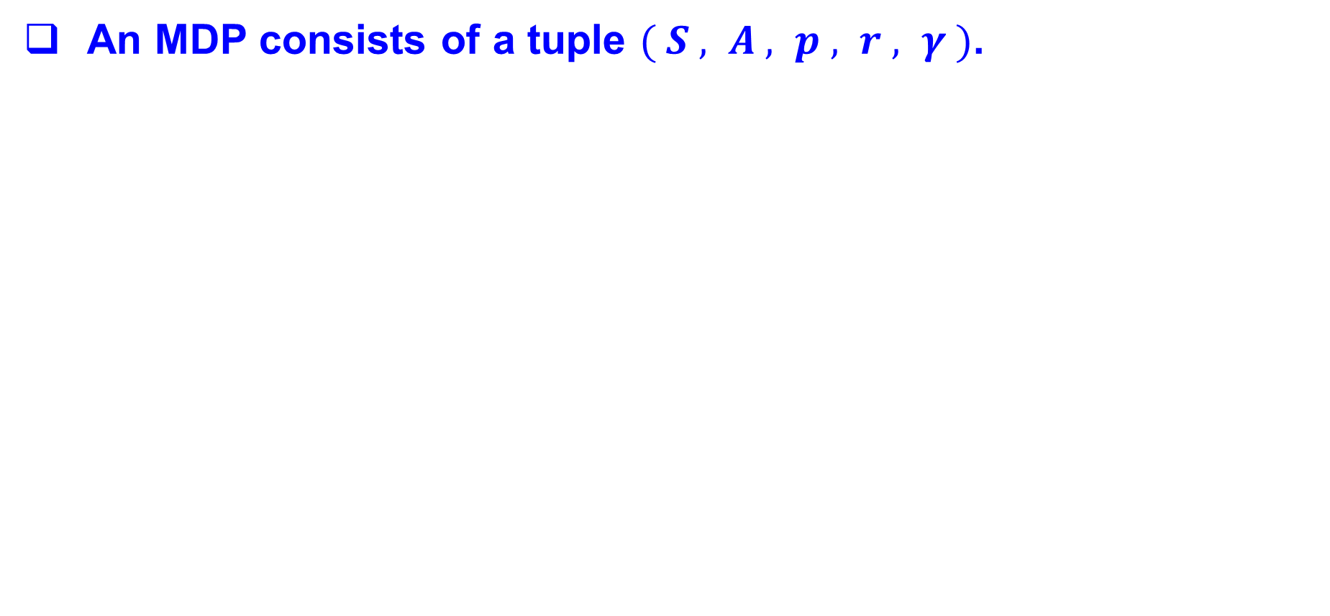
Markov Decision Process (MDP)
An MDP consists of a tuple $( S , A , p , r , γ )$.

Slide 6

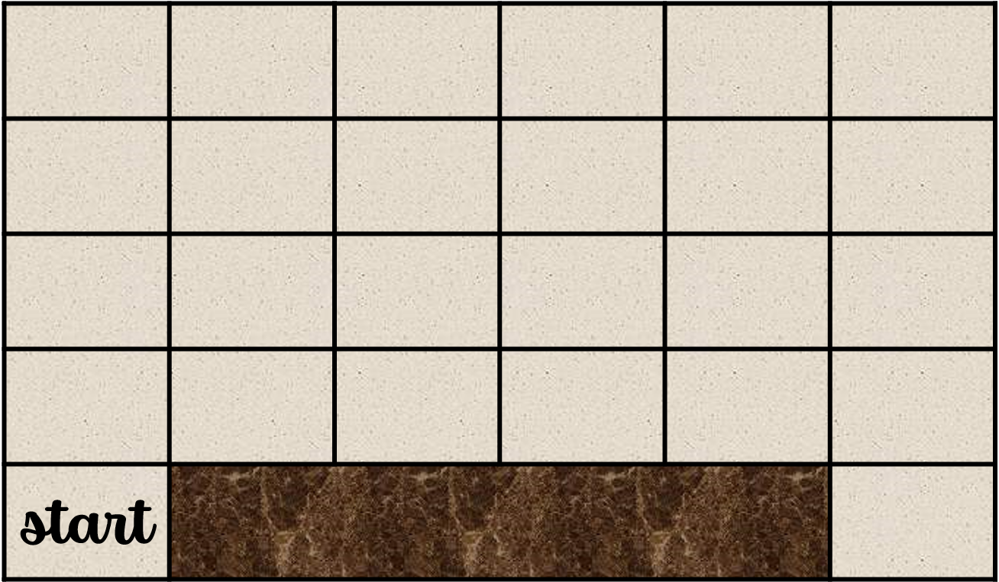

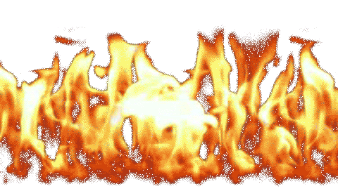

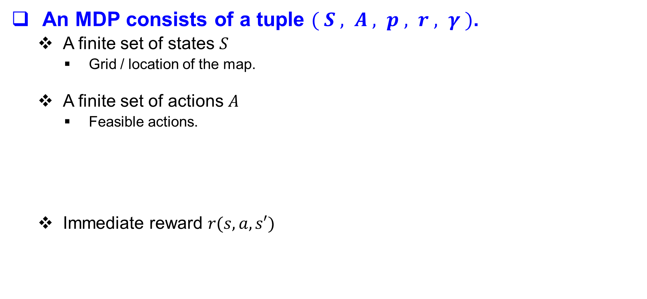
Markov Decision Process (MDP)
An MDP consists of a tuple $( S , A , p , r , γ )$.
A finite set of states $S$
Grid / location of the map.
A finite set of actions $A$
Feasible actions.
A transition model $p(s,a, s′)$
Probability of ending up in $s′$ given state $s$ and action $a$.
Immediate reward $r(s,a,s′)$
Discount factor $γ∈[0,1]$
-1
-100
+1

Slide 7

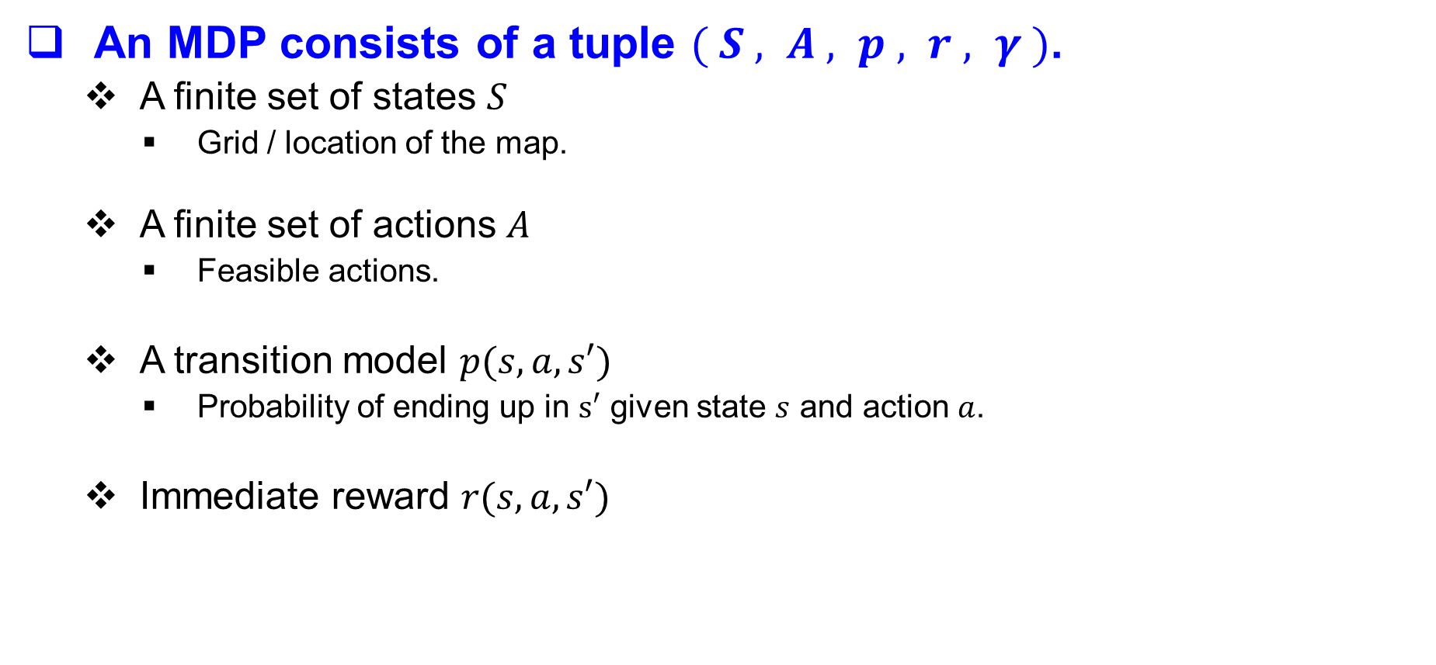
Markov Decision Process (MDP)
An MDP consists of a tuple $( S , A , p , r , γ )$.
A finite set of states $S$
Grid / location of the map.
A finite set of actions $A$
Feasible actions.
A transition model $p(s,a, s′)$
Probability of ending up in $s′$ given state $s$ and action $a$.
Immediate reward $r(s,a,s′)$
Discount factor $γ∈[0,1]$
Stochastic transition
80%
10%
10%
Notes:
Imagine strong wind from random direction

Slide 8




Markov Decision Process (MDP)
An MDP consists of a tuple $( S , A , p , r , γ )$.
A finite set of states $S$
Grid / location of the map.
A finite set of actions $A$
Feasible actions.
A transition model $p(s,a, s′)$
Probability of ending up in $s′$ given state $s$ and action $a$.
Immediate reward $r(s,a,s′)$
Discount factor $γ∈[0,1]$

Slide 9
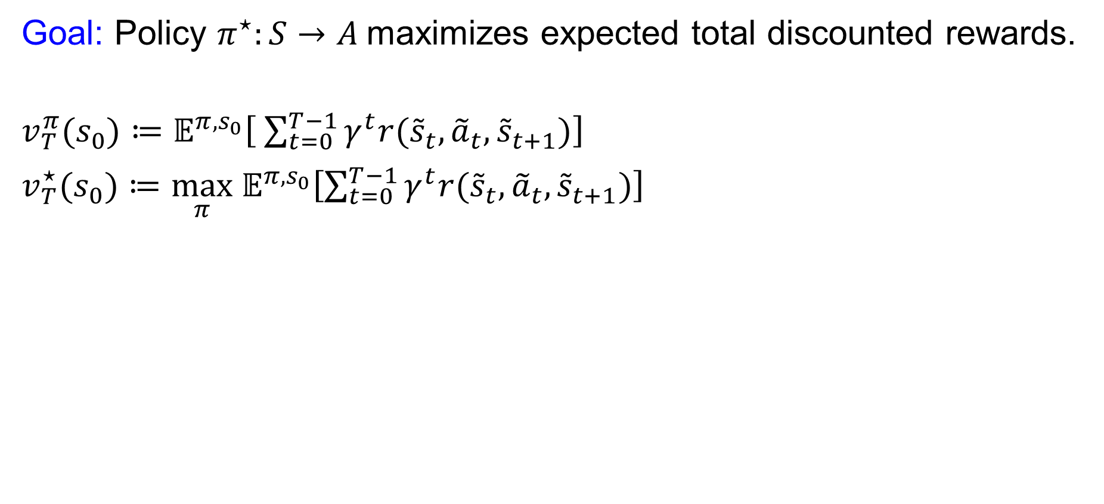
Markov Decision Process (MDP)
Goal: Policy $π^{⋆}:S→A$maximizes expected total discounted rewards.
$v_{T}^{π}(s_{0})≔𝔼^{π,s_{0}}\left[ \sum_{t=0}^{T−1}{γ^{t}r({\tilde{s}}_{t},{\tilde{a}}_{t},{\tilde{s}}_{t+1})}\right]$
$v_{T}^{⋆}(s_{0})≔\max_{π} 𝔼^{π,s_{0}}\left[\sum_{t=0}^{T−1}{γ^{t}r({\tilde{s}}_{t},{\tilde{a}}_{t},{\tilde{s}}_{t+1})}\right]$
Solution: Dynamic Programming (Value Iteration)
$$v_{t+1}^{⋆}\left(s\right)=\max_{a∈A} 𝔼[ r\left(s,a,\tilde{s}′\right)+γ v_{t}^{⋆}\left(\tilde{s}′\right) ]$$
$$π_{t+1}^{⋆}\left(s\right)=\underset{a∈A}{argmax} 𝔼[ r\left(s,a,\tilde{s}′\right)+γ v_{t}^{⋆}\left(\tilde{s}′\right) ]$$
→ | → | → | → | → | ↓
→ | → | → | → | → | ↓
→ | → | → | → | → | ↓
→ | → | → | → | → | ↓
↑ | ☠ |  |  |  | 💎

Slide 10
Markov Decision Process (MDP)
Goal: Policy $π^{⋆}:S→A$maximizes expected total discounted rewards.
$v_{T}^{π}(s_{0})≔𝔼^{π,s_{0}}\left[ \sum_{t=0}^{T−1}{γ^{t}r({\tilde{s}}_{t},{\tilde{a}}_{t},{\tilde{s}}_{t+1})}\right]$
$v_{T}^{⋆}(s_{0})≔\max_{π} 𝔼^{π,s_{0}}\left[\sum_{t=0}^{T−1}{γ^{t}r({\tilde{s}}_{t},{\tilde{a}}_{t},{\tilde{s}}_{t+1})}\right]$
Solution: Dynamic Programming (Value Iteration)
$$v_{t+1}^{⋆}\left(s\right)=\max_{a∈A} 𝔼[ r\left(s,a,\tilde{s}′\right)+γ v_{t}^{⋆}\left(\tilde{s}′\right) ]$$
$$π_{t+1}^{⋆}\left(s\right)=\underset{a∈A}{argmax} 𝔼[ r\left(s,a,\tilde{s}′\right)+γ v_{t}^{⋆}\left(\tilde{s}′\right) ]$$
→ | → | → | → | → | ↓
→ | → | → | → | → | ↓
→ | → | → | → | → | ↓
→ | → | → | → | → | ↓
↑ | ☠ |  |  |  | 💎
80%
10%
10%

Slide 11
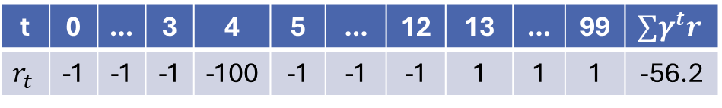
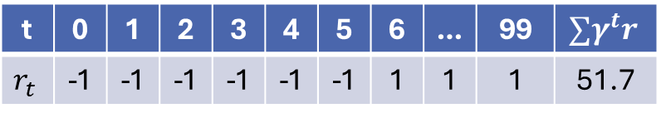
Dynamic Program ( Value Iteration )
Stochastic model
1st run
2nd run
→ | → | → | → | → | ↓
→ | → | → | → | → | ↓
→ | → | → | → | → | ↓
→ | → | → | → | → | ↓
↑ | ☠ |  |  |  | 💎
→ | → | → | → | → | ↓
→ | → | → | → | → | ↓
→ | → | → | → | → | ↓
→ | → | → | → | → | ↓
↑ | ☠ |  |  |  | 💎
t | 0 | 1 | 2 | 3 | 4 | 5 | 6 | … | 99 | $$∑γ^{t}r$$
$$r_{t}$$ | -1 | -1 | -1 | -1 | -1 | -1 | 1 | 1 | 1 | 51.7
t | 0 | … | 3 | 4 | 5 | … | 12 | 13 | … | 99 | $$∑γ^{t}r$$
$$r_{t}$$ | -1 | -1 | -1 | -100 | -1 | -1 | -1 | 1 | 1 | 1 | -56.2

Slide 12
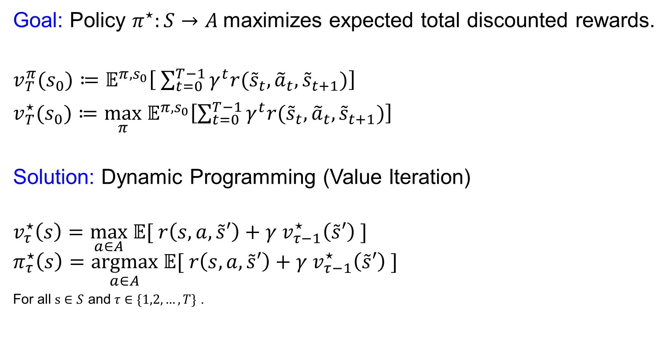
Dynamic Program ( Value Iteration )
Goal: Policy $π^{⋆}:S→A$maximizes expected total discounted rewards.
$v_{T}^{π}(s_{0})≔𝔼^{π,s_{0}}\left[ \sum_{t=0}^{T−1}{γ^{t}r({\tilde{s}}_{t},{\tilde{a}}_{t},{\tilde{s}}_{t+1})}\right]$
$v_{T}^{⋆}(s_{0})≔\max_{π} 𝔼^{π,s_{0}}\left[\sum_{t=0}^{T−1}{γ^{t}r({\tilde{s}}_{t},{\tilde{a}}_{t},{\tilde{s}}_{t+1})}\right]$
Solution: Dynamic Programming (Value Iteration)
$$v_{τ}^{⋆}\left(s\right)=\max_{a∈A} 𝔼[ r\left(s,a,\tilde{s}′\right)+γ v_{τ−1}^{⋆}\left(\tilde{s}′\right) ]$$
$$π_{τ}^{⋆}\left(s\right)=\underset{a∈A}{argmax} 𝔼[ r\left(s,a,\tilde{s}′\right)+γ v_{τ−1}^{⋆}\left(\tilde{s}′\right) ]$$
For all $s∈S$ and $τ∈\{1,2,…, T\}$ .
→ | → | → | → | → | ↓
→ | → | → | → | → | ↓
→ | → | → | → | → | ↓
→ | → | → | → | → | ↓
↑ | ☠ |  |  |  | 💎
Notes:
Tilde represent Random variable

Slide 13
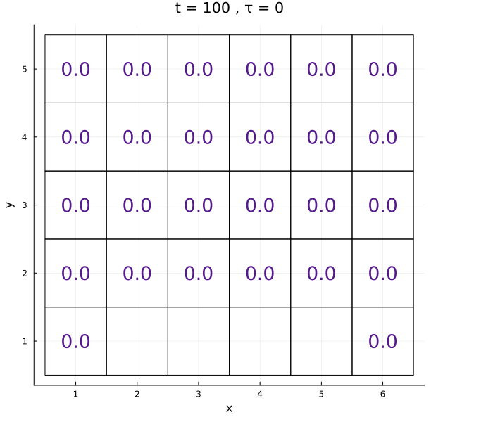
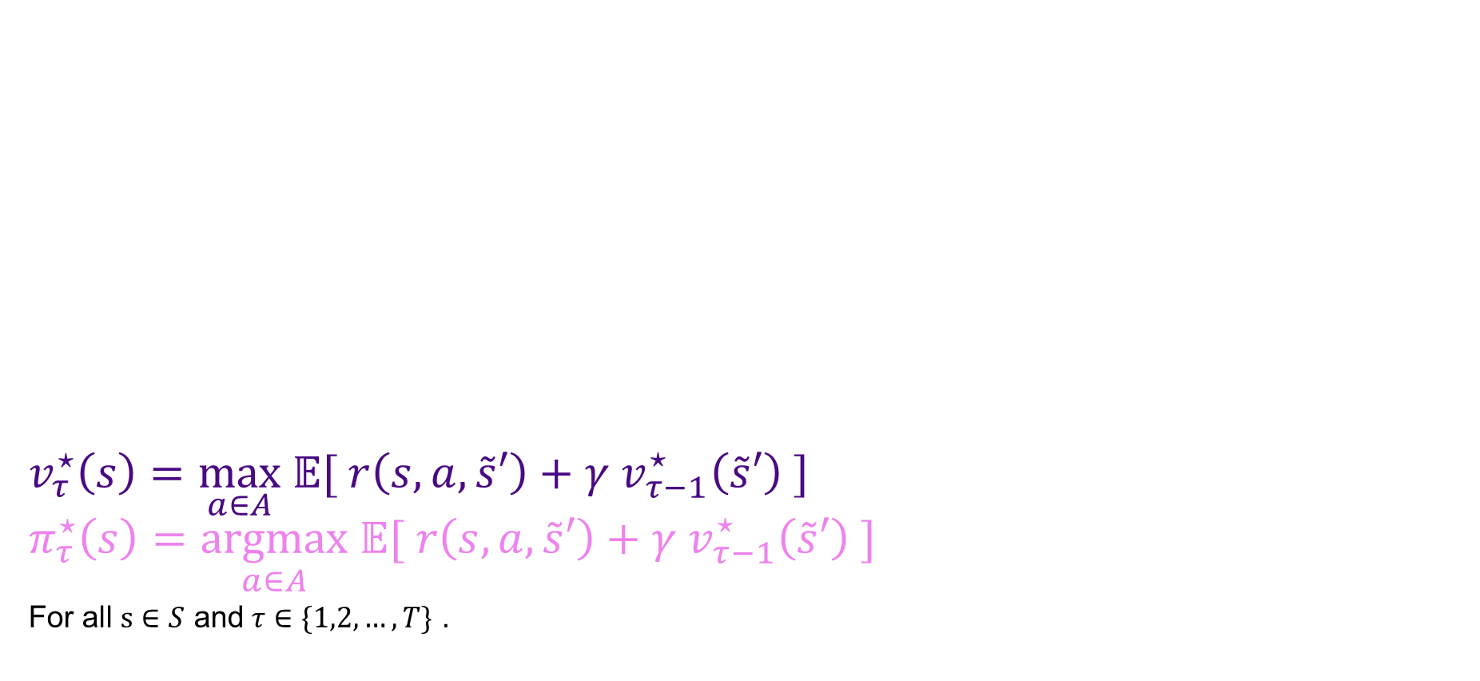
Dynamic Program ( Value Iteration )
Goal: Policy $π^{⋆}:S→A$maximizes expected total discounted rewards.
$v_{T}^{π}(s_{0})≔𝔼^{π,s_{0}}\left[ \sum_{t=0}^{T−1}{γ^{t}r({\tilde{s}}_{t},{\tilde{a}}_{t},{\tilde{s}}_{t+1})}\right]$
$v_{T}^{⋆}(s_{0})≔\max_{π} 𝔼^{π,s_{0}}\left[\sum_{t=0}^{T−1}{γ^{t}r({\tilde{s}}_{t},{\tilde{a}}_{t},{\tilde{s}}_{t+1})}\right]$
Solution: Dynamic Programming (Value Iteration)
$$v_{τ}^{⋆}\left(s\right)=\max_{a∈A} 𝔼[ r\left(s,a,\tilde{s}′\right)+γ v_{τ−1}^{⋆}\left(\tilde{s}′\right) ]$$
$$π_{τ}^{⋆}\left(s\right)=\underset{a∈A}{argmax} 𝔼[ r\left(s,a,\tilde{s}′\right)+γ v_{τ−1}^{⋆}\left(\tilde{s}′\right) ]$$
For all $s∈S$ and $τ∈\{1,2,…, T\}$ .
Let’s assume T=100, we care about a 100 horizon MDP.

Slide 14
Dynamic Program ( Value Iteration )
Goal: Policy $π^{⋆}:S→A$maximizes expected total discounted rewards.
$v_{T}^{π}(s_{0})≔𝔼^{π,s_{0}}\left[ \sum_{t=0}^{T−1}{γ^{t}r({\tilde{s}}_{t},{\tilde{a}}_{t},{\tilde{s}}_{t+1})}\right]$
$v_{T}^{⋆}(s_{0})≔\max_{π} 𝔼^{π,s_{0}}\left[\sum_{t=0}^{T−1}{γ^{t}r({\tilde{s}}_{t},{\tilde{a}}_{t},{\tilde{s}}_{t+1})}\right]$
Solution: Dynamic Programming (Value Iteration)
$$v_{τ}^{⋆}\left(s\right)=\max_{a∈A} 𝔼[ r\left(s,a,\tilde{s}′\right)+γ v_{τ−1}^{⋆}\left(\tilde{s}′\right) ]$$
$$π_{τ}^{⋆}\left(s\right)=\underset{a∈A}{argmax} 𝔼[ r\left(s,a,\tilde{s}′\right)+γ v_{τ−1}^{⋆}\left(\tilde{s}′\right) ]$$
For all $s∈S$ and $τ∈\{1,2,…, T\}$ .

Slide 15
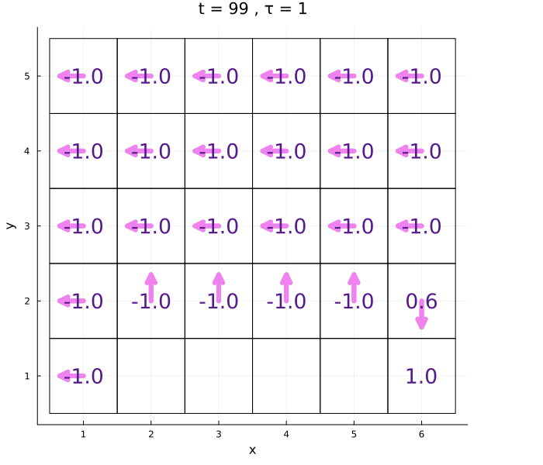
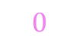
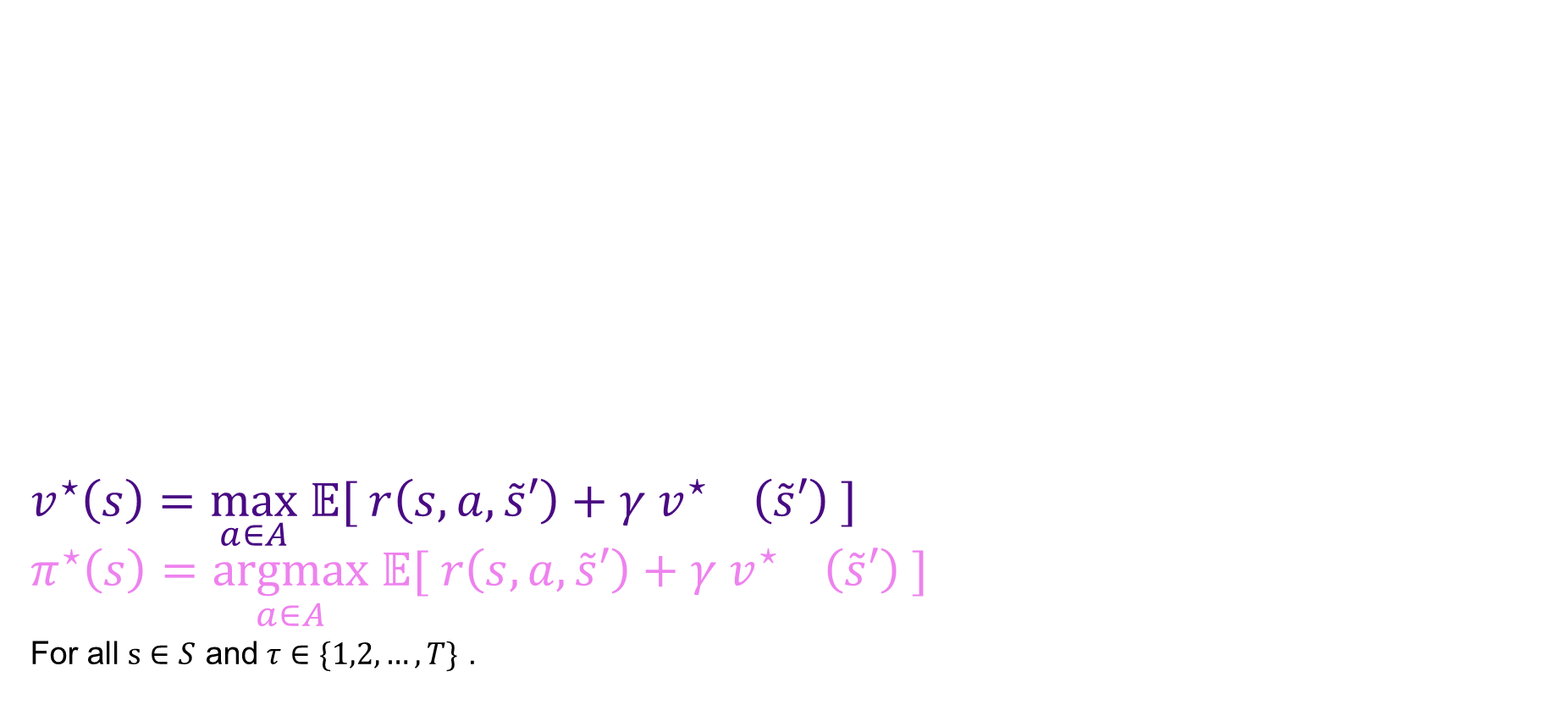
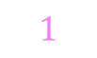

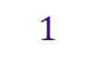
Dynamic Program ( Value Iteration )
Goal: Policy $π^{⋆}:S→A$maximizes expected total discounted rewards.
$v_{T}^{π}(s_{0})≔𝔼^{π,s_{0}}\left[ \sum_{t=0}^{T−1}{γ^{t}r({\tilde{s}}_{t},{\tilde{a}}_{t},{\tilde{s}}_{t+1})}\right]$
$v_{T}^{⋆}(s_{0})≔\max_{π} 𝔼^{π,s_{0}}\left[\sum_{t=0}^{T−1}{γ^{t}r({\tilde{s}}_{t},{\tilde{a}}_{t},{\tilde{s}}_{t+1})}\right]$
Solution: Dynamic Programming (Value Iteration)
$$v_{τ}^{⋆}\left(s\right)=\max_{a∈A} 𝔼[ r\left(s,a,\tilde{s}′\right)+γ v_{τ−1}^{⋆}\left(\tilde{s}′\right) ]$$
$$π_{τ}^{⋆}\left(s\right)=\underset{a∈A}{argmax} 𝔼[ r\left(s,a,\tilde{s}′\right)+γ v_{τ−1}^{⋆}\left(\tilde{s}′\right) ]$$
For all $s∈S$ and $τ∈\{1,2,…, T\}$ .
$$1$$
$$0$$
$$1$$
$$0$$

Slide 16
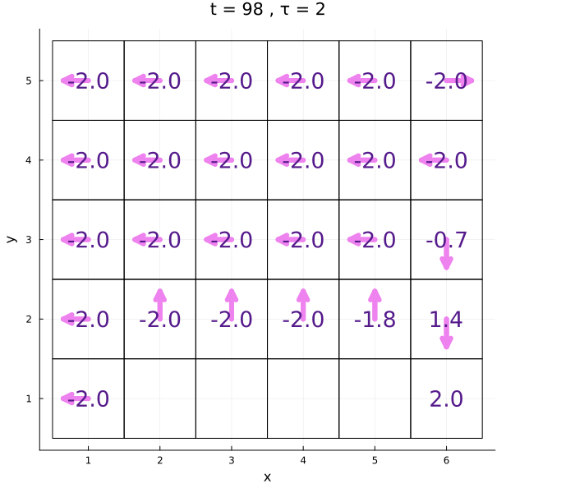
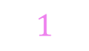

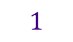
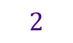
Dynamic Program ( Value Iteration )
Goal: Policy $π^{⋆}:S→A$maximizes expected total discounted rewards.
$v_{T}^{π}(s_{0})≔𝔼^{π,s_{0}}\left[ \sum_{t=0}^{T−1}{γ^{t}r({\tilde{s}}_{t},{\tilde{a}}_{t},{\tilde{s}}_{t+1})}\right]$
$v_{T}^{⋆}(s_{0})≔\max_{π} 𝔼^{π,s_{0}}\left[\sum_{t=0}^{T−1}{γ^{t}r({\tilde{s}}_{t},{\tilde{a}}_{t},{\tilde{s}}_{t+1})}\right]$
Solution: Dynamic Programming (Value Iteration)
$$v_{τ}^{⋆}\left(s\right)=\max_{a∈A} 𝔼[ r\left(s,a,\tilde{s}′\right)+γ v_{τ−1}^{⋆}\left(\tilde{s}′\right) ]$$
$$π_{τ}^{⋆}\left(s\right)=\underset{a∈A}{argmax} 𝔼[ r\left(s,a,\tilde{s}′\right)+γ v_{τ−1}^{⋆}\left(\tilde{s}′\right) ]$$
For all $s∈S$ and $τ∈\{1,2,…, T\}$ .
$$2$$
$$1$$
$$2$$
$$1$$

Slide 17
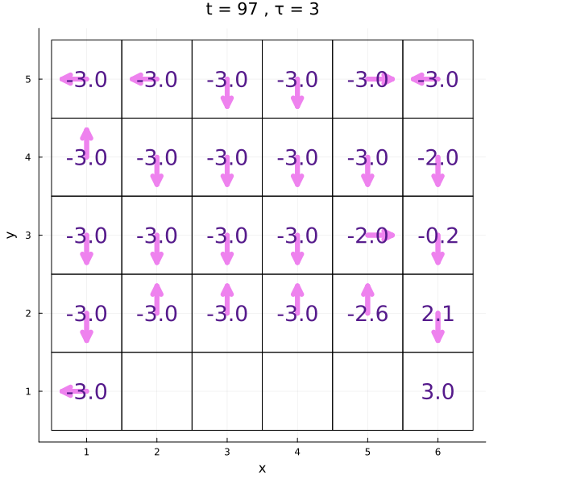


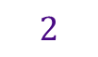
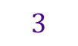
Dynamic Program ( Value Iteration )
Goal: Policy $π^{⋆}:S→A$maximizes expected total discounted rewards.
$v_{T}^{π}(s_{0})≔𝔼^{π,s_{0}}\left[ \sum_{t=0}^{T−1}{γ^{t}r({\tilde{s}}_{t},{\tilde{a}}_{t},{\tilde{s}}_{t+1})}\right]$
$v_{T}^{⋆}(s_{0})≔\max_{π} 𝔼^{π,s_{0}}\left[\sum_{t=0}^{T−1}{γ^{t}r({\tilde{s}}_{t},{\tilde{a}}_{t},{\tilde{s}}_{t+1})}\right]$
Solution: Dynamic Programming (Value Iteration)
$$v_{τ}^{⋆}\left(s\right)=\max_{a∈A} 𝔼[ r\left(s,a,\tilde{s}′\right)+γ v_{τ−1}^{⋆}\left(\tilde{s}′\right) ]$$
$$π_{τ}^{⋆}\left(s\right)=\underset{a∈A}{argmax} 𝔼[ r\left(s,a,\tilde{s}′\right)+γ v_{τ−1}^{⋆}\left(\tilde{s}′\right) ]$$
For all $s∈S$ and $τ∈\{1,2,…, T\}$ .
$$3$$
$$2$$
$$3$$
$$2$$

Slide 18

Dynamic Program ( Value Iteration )
Goal: Policy $π^{⋆}:S→A$maximizes expected total discounted rewards.
$v_{T}^{π}(s_{0})≔𝔼^{π,s_{0}}\left[ \sum_{t=0}^{T−1}{γ^{t}r({\tilde{s}}_{t},{\tilde{a}}_{t},{\tilde{s}}_{t+1})}\right]$
$v_{T}^{⋆}(s_{0})≔\max_{π} 𝔼^{π,s_{0}}\left[\sum_{t=0}^{T−1}{γ^{t}r({\tilde{s}}_{t},{\tilde{a}}_{t},{\tilde{s}}_{t+1})}\right]$
Solution: Dynamic Programming (Value Iteration)
$$v_{τ}^{⋆}\left(s\right)=\max_{a∈A} 𝔼[ r\left(s,a,\tilde{s}′\right)+γ v_{τ−1}^{⋆}\left(\tilde{s}′\right) ]$$
$$π_{τ}^{⋆}\left(s\right)=\underset{a∈A}{argmax} 𝔼[ r\left(s,a,\tilde{s}′\right)+γ v_{τ−1}^{⋆}\left(\tilde{s}′\right) ]$$
For all $s∈S$ and $τ∈\{1,2,…, T\}$ .

Slide 19
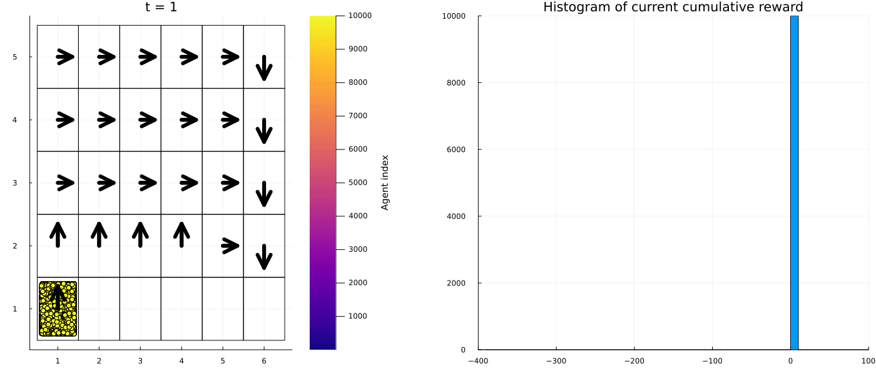
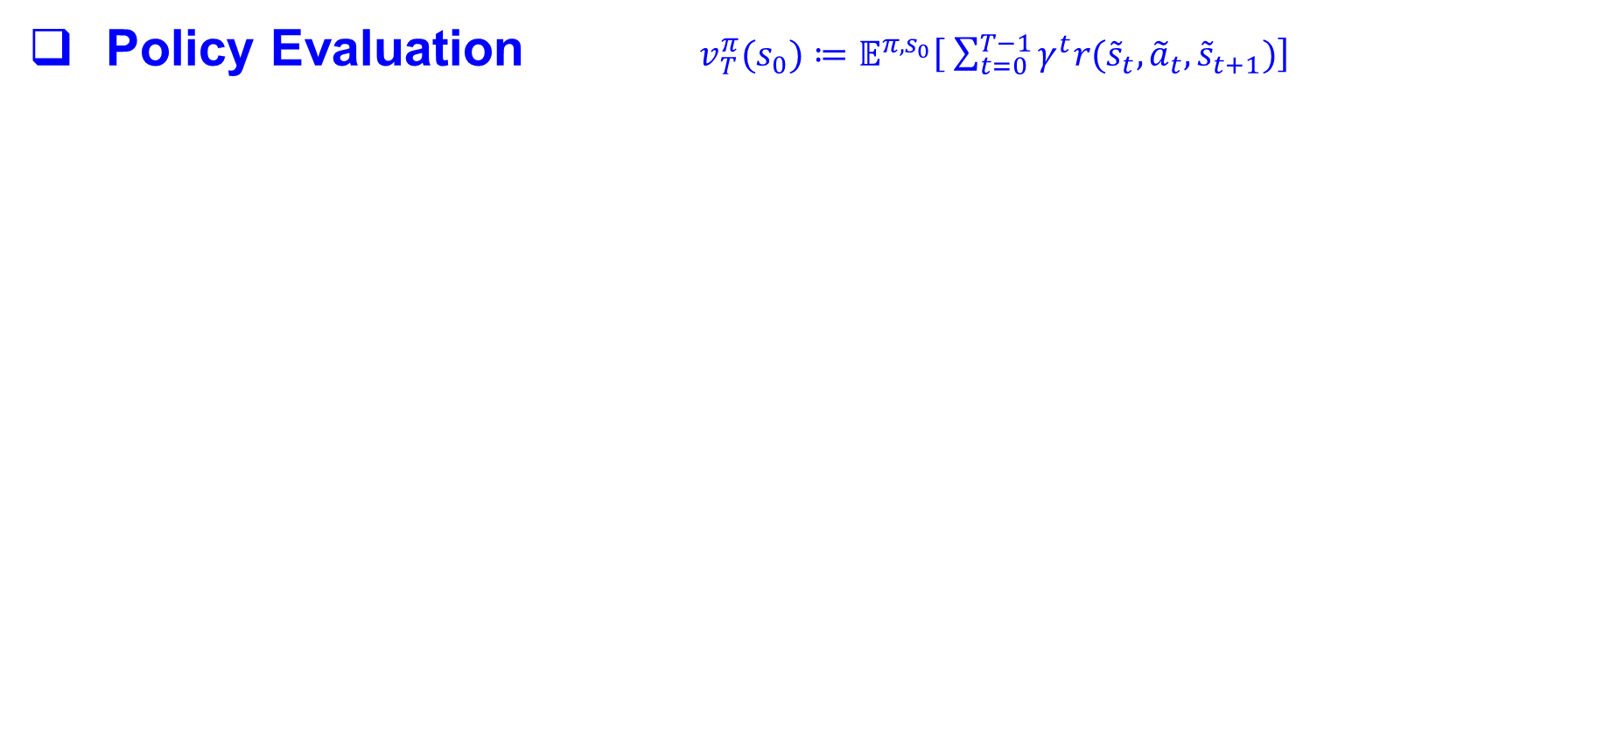
Markov Decision Process (MDP)
Policy Evaluation $v_{T}^{π}(s_{0})≔𝔼^{π,s_{0}}\left[ \sum_{t=0}^{T−1}{γ^{t}r({\tilde{s}}_{t},{\tilde{a}}_{t},{\tilde{s}}_{t+1})}\right]$
frequency
discounted cumulative reward

Slide 20
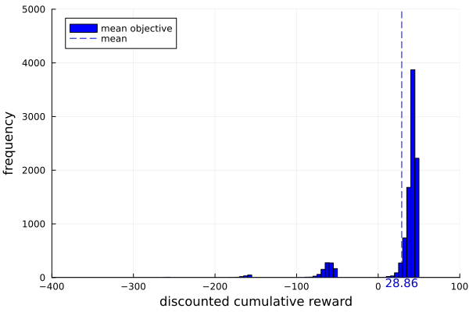
Markov Decision Process (MDP)
Concern

Slide 21


Markov Decision Process (MDP)
Concern
13%
( Millions of dollars )

Slide 22

Markov Decision Process (MDP)
Concern
Is there a less risky alternative that trades off some mean reward?
13%
( Millions of dollars )

Slide 23
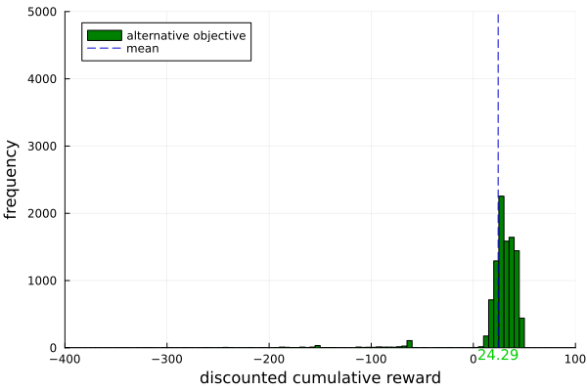
Markov Decision Process (MDP)
Alternative objective
13%
4%
( Millions of dollars )

Slide 24
Risk Averse Decision Making
Use case
Motion Planning
[Braun et al.,2011, Hakobyan and Yang, 2021, Ahmadi et al., 2021]
Autonomous System
[Wang and Chapman,2022, Jin et al., 2019]
Healthcare
[Zhong, 2020, Kose, 2016, Singh et al., 2020]
Investment
[Min et al., 2022]
Risk averse decision making is often preferable when safety, human lives, or large amounts of money are at stake.
Notes:
Synthetic example

Slide 25

Preliminary 2
Risk $𝕄$easure

Slide 26
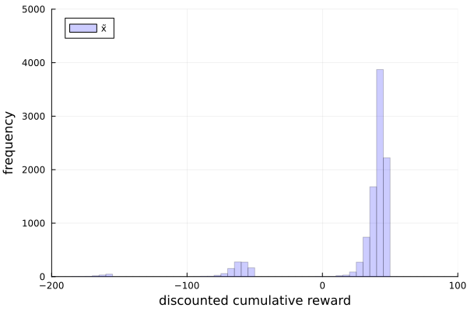

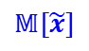
Risk $𝕄$easure
Measure $𝕄\left[\tilde{x}\right]$
$$𝕄[\tilde{x}]$$

Slide 27
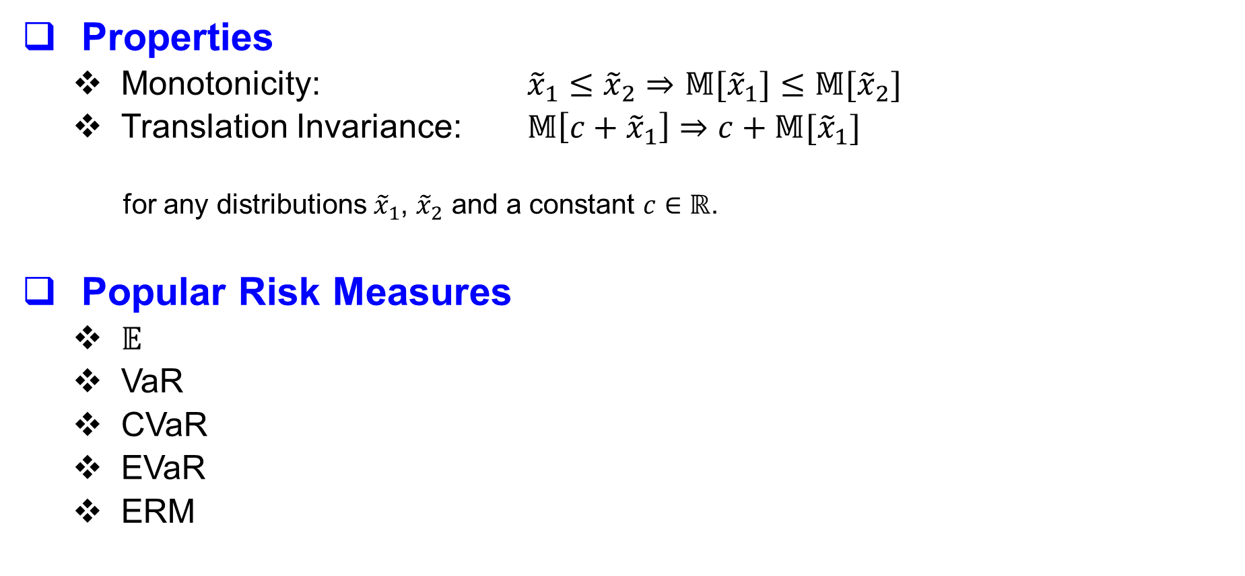
Monetary Risk $𝕄$easure
Properties
Monotonicity: ${\tilde{x}}_{1}≤{\tilde{x}}_{2}⇒𝕄[{\tilde{x}}_{1}]≤𝕄[{\tilde{x}}_{2}]$
Translation Invariance: $𝕄\left[c+{\tilde{x}}_{1}\right]⇒c+𝕄[{\tilde{x}}_{1}]$
for any distributions ${\tilde{x}}_{1}$, ${\tilde{x}}_{2}$ and a constant $c∈ℝ$.
Popular Risk Measures
$𝔼$
VaR
CVaR
EVaR
ERM

Slide 28
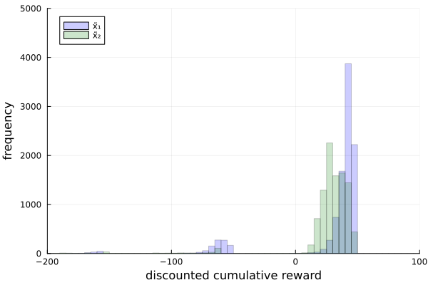
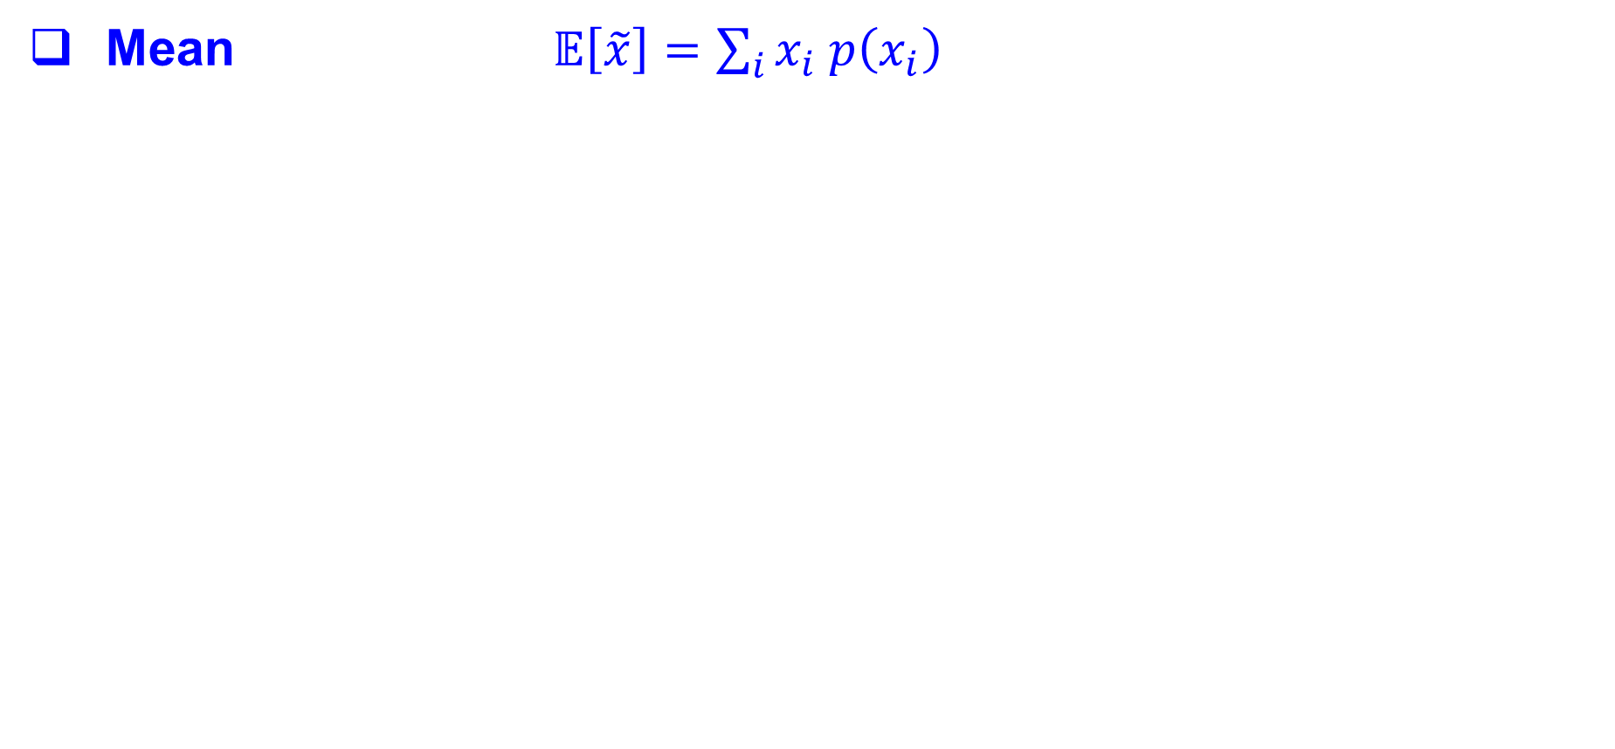
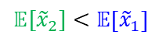
Risk $𝕄$easure ( Mean )
Mean $𝔼\left[\tilde{x}\right]=\sum_{i}{x_{i} p\left(x_{i}\right)}$
$$𝔼[{\tilde{x}}_{2}]<𝔼\left[{\tilde{x}}_{1}\right]$$

Slide 29
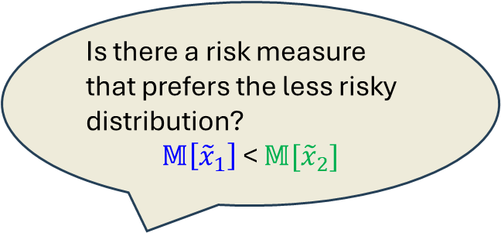
Risk $𝕄$easure ( Mean )
Mean $𝔼\left[\tilde{x}\right]=\sum_{i}{x_{i} p\left(x_{i}\right)}$
Is there a risk measure that prefers the less risky distribution?
$𝕄\left[{\tilde{x}}_{1}\right]$ < $𝕄[{\tilde{x}}_{2}]$
$$𝔼[{\tilde{x}}_{2}]<𝔼\left[{\tilde{x}}_{1}\right]$$

Slide 30
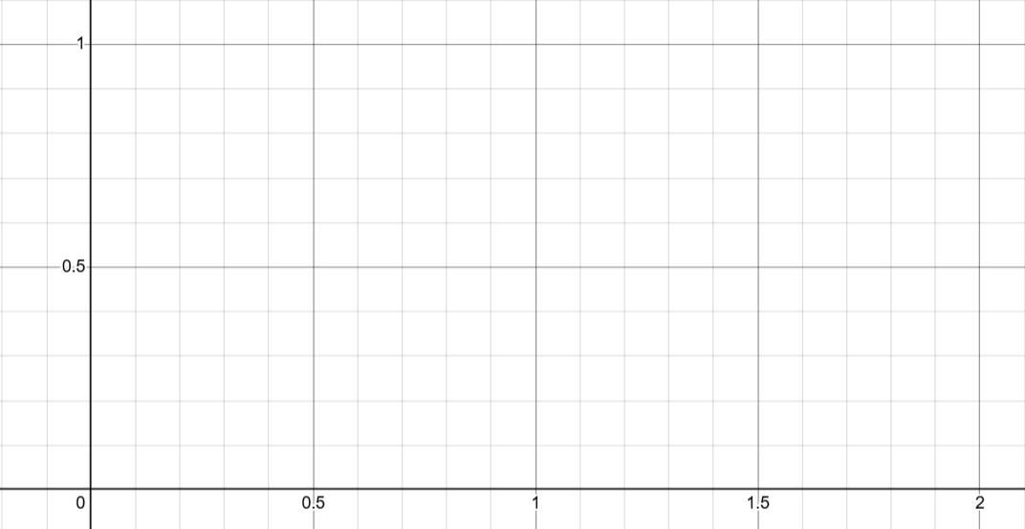
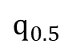
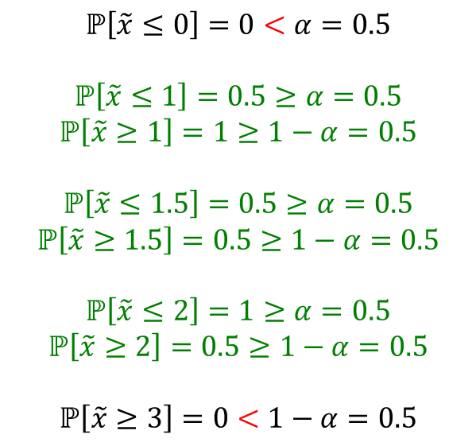
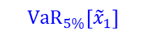
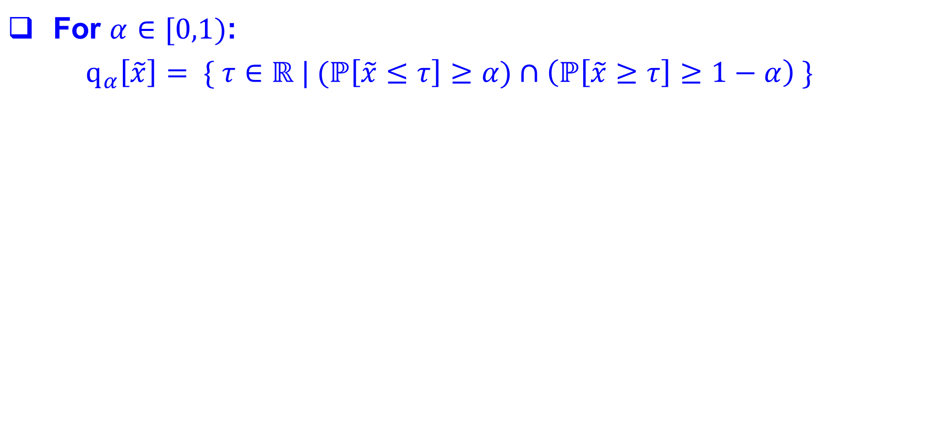
Risk $𝕄$easure ( quantile )
$\text{F}\text{or} α∈[0,1)$:
$q_{α}\left[\tilde{x}\right]= \{ τ∈ℝ | (ℙ\left[\tilde{x}≤τ\right]≥α)∩\left(ℙ\left[\tilde{x}≥τ\right]≥1−α\right) \}$
$$ℙ\left[\tilde{x}≤0\right]=0<α=0.5$$
$$ℙ\left[\tilde{x}≤1\right]=0.5≥α=0.5$$
$$ℙ\left[\tilde{x}≥1\right]=1≥1−α=0.5$$
$$ℙ\left[\tilde{x}≤1.5\right]=0.5≥α=0.5$$
$$ℙ\left[\tilde{x}≥1.5\right]=0.5≥1−α=0.5$$
$$ℙ\left[\tilde{x}≤2\right]=1≥α=0.5$$
$$ℙ\left[\tilde{x}≥2\right]=0.5≥1−α=0.5$$
$$ℙ\left[\tilde{x}≥3\right]=0<1−α=0.5$$
$$q_{0.5}$$
probability
value
$${VaR}_{5\%}\left[{\tilde{x}}_{1}\right]$$

Slide 31

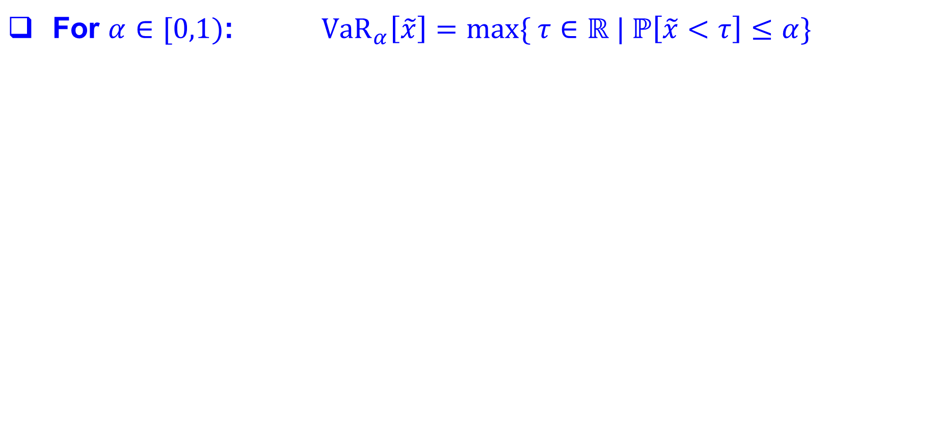

Risk $𝕄$easure ( VaR )
$\text{F}\text{or} α∈[0,1)$: ${VaR}_{α}\left[\tilde{x}\right]=max\{ τ∈ℝ | ℙ\left[\tilde{x}<τ\right]≤α\}$
${VaR}_{5\%}\left[{\tilde{x}}_{1}\right]$ ${VaR}_{5\%}[{\tilde{x}}_{2}]$

Slide 32
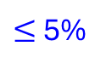

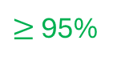

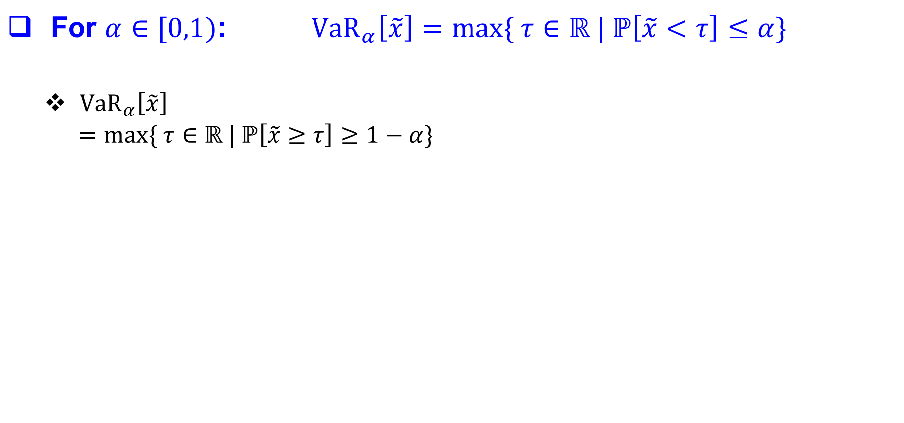
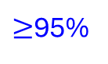
Risk $𝕄$easure ( VaR )
$\text{F}\text{or} α∈[0,1)$: ${VaR}_{α}\left[\tilde{x}\right]=max\{ τ∈ℝ | ℙ\left[\tilde{x}<τ\right]≤α\}$
${VaR}_{α}\left[\tilde{x}\right]$
$=max\{ τ∈ℝ | ℙ\left[\tilde{x}≥τ\right]≥1−α\}$
$≤$5%
$≥$95%
$≥$95%
$≤$5%
${VaR}_{5\%}\left[{\tilde{x}}_{1}\right]$ ${VaR}_{5\%}[{\tilde{x}}_{2}]$

Slide 33
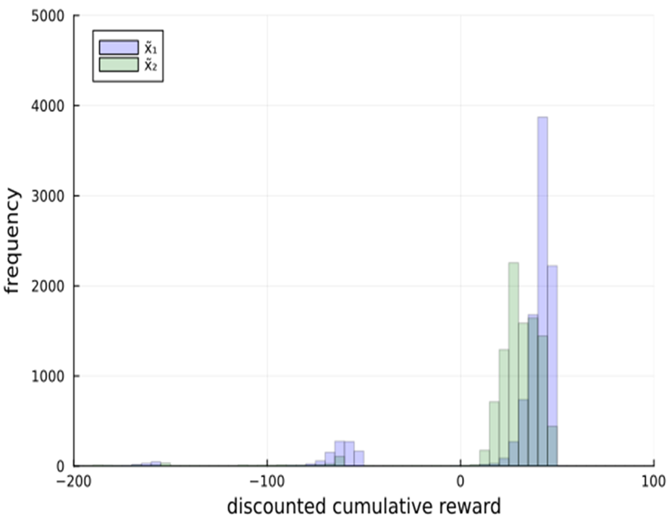
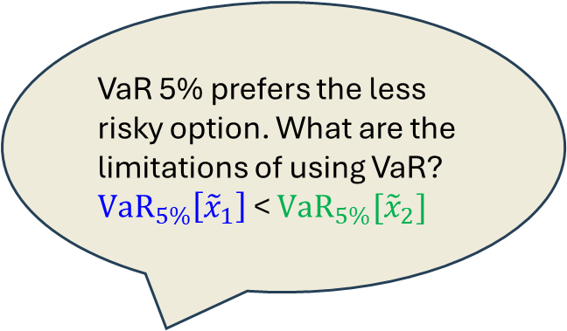
Risk $𝕄$easure ( VaR )
$\text{F}\text{or} α∈[0,1)$: ${VaR}_{α}\left[\tilde{x}\right]=max\{ τ∈ℝ | ℙ\left[\tilde{x}<τ\right]≤α\}$
${VaR}_{α}\left[\tilde{x}\right]$
$=max\{ τ∈ℝ | ℙ\left[\tilde{x}≥τ\right]≥1−α\}$
$≤$5%
$≥$95%
$≥$95%
$≤$5%
VaR 5% prefers the less risky option. What are the limitations of using VaR?
${VaR}_{5\%}\left[{\tilde{x}}_{1}\right]$ < ${VaR}_{5\%}[{\tilde{x}}_{2}]$
${VaR}_{5\%}\left[{\tilde{x}}_{1}\right]$ ${VaR}_{5\%}[{\tilde{x}}_{2}]$

Slide 34
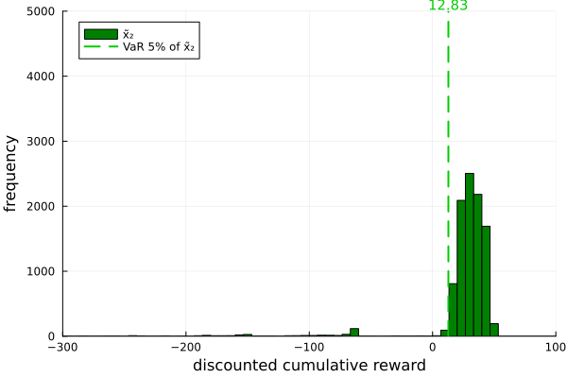
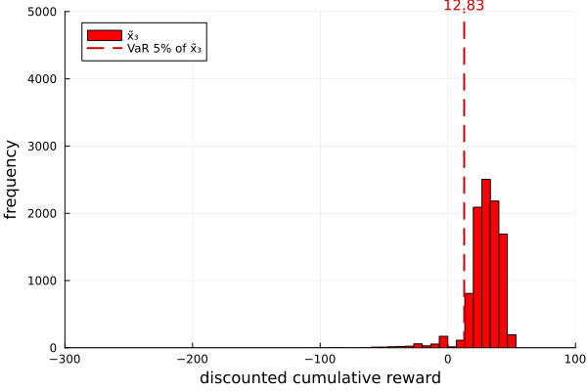
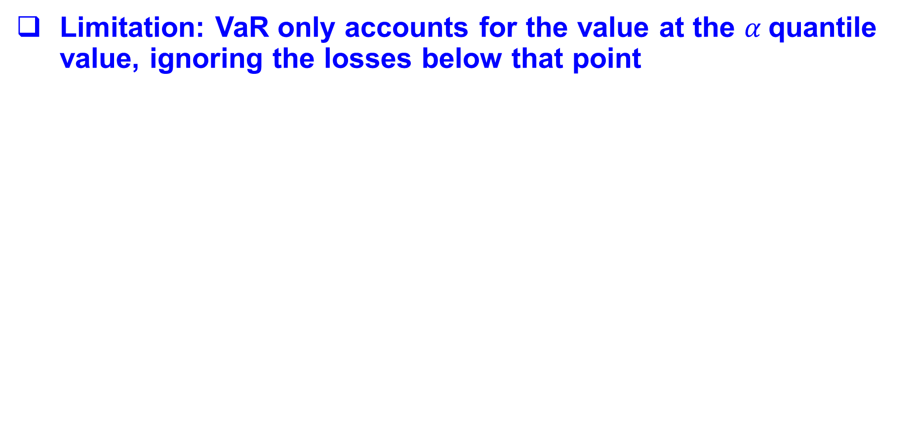
Risk $𝕄$easure ( VaR )
Limitation: VaR only accounts for the value at the $α$quantile value, ignoring the losses below that point

Slide 35

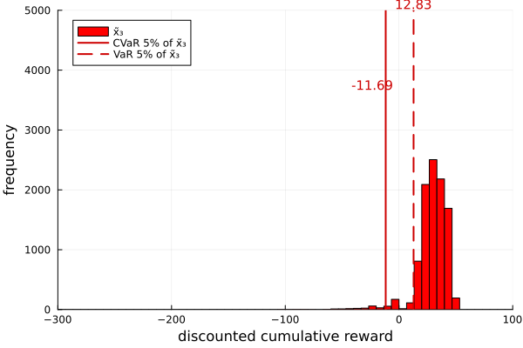

Risk $𝕄$easure ( CVaR )
primal
dual
${CVaR}_{α}\left[\tilde{x}\right]=\sup_{τ∈ℝ}\{ τ− \frac{𝔼{\left[τ −\tilde{x}\right]}_{+}}{α}\}=inf\left\{ ξ^{T}x \right| ξ∈Δ_{𝕏},αξ≤q\}$
Notes:
CVaR captures the expected loss in the worst α-fraction of the distribution.

Slide 36


Risk $𝕄$easure ( CVaR )
${CVaR}_{α}\left[\tilde{x}\right]=\sup_{τ∈ℝ}\{ τ− \frac{𝔼{\left[τ −\tilde{x}\right]}_{+}}{α}\}=inf\left\{ ξ^{T}x \right| ξ∈Δ_{𝕏},αξ≤q\}$

Slide 37


Risk $𝕄$easure ( CVaR )
${CVaR}_{α}\left[\tilde{x}\right]=\sup_{τ∈ℝ}\{ τ− \frac{𝔼{\left[τ −\tilde{x}\right]}_{+}}{α}\}=inf\left\{ ξ^{T}x \right| ξ∈Δ_{𝕏},αξ≤q\}$

Slide 38


Risk $𝕄$easure ( CVaR )
${CVaR}_{α}\left[\tilde{x}\right]=\sup_{τ∈ℝ}\{ τ− \frac{𝔼{\left[τ −\tilde{x}\right]}_{+}}{α}\}=inf\left\{ ξ^{T}x \right| ξ∈Δ_{𝕏},αξ≤q\}$
CVaR considers the 𝛼 tail distribution. Are there any limitations or drawbacks of using CVaR?

Slide 39


Risk $𝕄$easure ( EVaR )
How can we distinguish between two distributions with similar tail behavior but different mean?

Slide 40










Risk $𝕄$easure ( ERM )
$$U_{β}\left(x\right)$$
${ERM}_{β}\left(\tilde{x}\right)= U_{β}^{−1}( 𝔼\left[U_{β}\left(\tilde{x}\right)\right] )$
$U_{β}\left(x\right)=\left\{\begin{aligned}\frac{{1−e}^{−βx}}{β} ,β>0 \\ x , β=0\end{aligned}\right.$
+8
+2.5
$$x$$
$$β$$
-25
Risk neutral
Risk averse
-8
Notes:
Law of diminishing return
Explain example in real life

Slide 41

Risk $𝕄$easure ( EVaR )
EVaR objective:
EVaR can be written as supremum over ERM
$${EVaR}_{α}\left[\tilde{x}\right]=\sup_{β>0} \left({ERM}_{β}\left[\tilde{x}\right]+\frac{\log\left(α\right)}{β}\right)$$
$$=inf \{ξ^{T}x|ξ∈Δ_{𝕏},\sum_{i}{ξ_{i} log \left(\frac{ξ_{i}}{q_{i}}\right)≤ log(α)}\}$$
Tightest Chernoff lower bound of VaR
$${{EVaR}_{α}[\tilde{x}]≤{CVaR}_{α}[\tilde{x}]≤VaR}_{α}\left[\tilde{x}\right]$$
primal
dual

Slide 42
Risk $𝕄$easure ( EVaR )
How can we distinguish between two distributions with similar tail risk but different mean returns?

Slide 43


Risk Sensitive MDP
Risk Measure:
$𝕄∈ \{ VaR , CVaR , EVaR , ERM \}$
Objective
$$\max_{π} 𝕄^{π,s_{0}}\left[ \sum_{t=0}^{T−1}{γ^{t}r({\tilde{s}}_{t},{\tilde{a}}_{t},{\tilde{s}}_{t+1})}\right]$$

Slide 44
Preliminary 3
Prior Work and Overview

Slide 45

Why is Risk Averse MDP Challenging?
Markov Decision Process
$$v_{T}^{⋆}(s)≔\max_{π} 𝔼^{π,s }\left[\sum_{t=0}^{T−1}{γ^{t}r({\tilde{s}}_{t},{\tilde{a}}_{t},{\tilde{s}}_{t+1})}\right]$$
Value Iteration (Dynamic Program)
$$v_{T}^{⋆}\left(s\right)=\max_{a∈A} 𝔼[ r\left(s,a,\tilde{s}′\right)+γ v_{T−1}^{⋆}\left(\tilde{s}′\right) ]$$

Slide 46


Why is Risk Averse MDP Challenging?
Markov Decision Process
$$v_{T}^{⋆}(s)≔\max_{π} 𝔼^{π,s }\left[\sum_{t=0}^{T−1}{γ^{t}r({\tilde{s}}_{t},{\tilde{a}}_{t},{\tilde{s}}_{t+1})}\right]$$
Value Iteration (Dynamic Program)
$$v_{T}^{⋆}\left(s\right)=\max_{a∈A} 𝔼[ r\left(s,a,\tilde{s}′\right)+γ\max_{π} 𝔼^{π }\left[\sum_{t=0}^{T−2}{γ^{t}r\left({\tilde{s}}_{t},{\tilde{a}}_{t},{\tilde{s}}_{t+1}\right) | {\tilde{s}}_{0}=\tilde{s}′}\right]]$$
Decompose the optimization of mean to optimization of conditional mean
$$v_{T−1}^{⋆}\left(\tilde{s}′\right)$$

Slide 47

Monetary Risk $𝕄$easure
 | Time consistency | Risk level interpretation | Positive homogeneity | Consider part of distribution | Sensitivity to risk
$$𝔼$$ | $$\text{✓}$$ | Not applicable | $$\text{✓}$$ | Whole | Not sensitive
$$VaR$$ | ✗ | Quantile ($α$) | $$\text{✓}$$ | $α$-point | Somewhat sensitive
$$CVaR$$ | ✗ | Mean of $(α)$-tail distribution | $$\text{✓}$$ | $α$-tail | Very sensitive
$$EVaR$$ | ✗ | Chernoff bound of $(α)$-quantile | $$\text{✓}$$ | Whole | Extremely sensitive
$$ERM$$ | $$\text{✓}$$ | Exponential utility function ($β$) | ✗ | Whole | Depends on $β$
Purpose | Support nested algorithm | Adjustable risk based on user preference | Extends naturally to discounted MDPs | Portion of the distribution | Mitigate risky outcome

Slide 48

Monetary Risk $𝕄$easure
 | Time consistency | Risk level interpretation | Positive homogeneity | Consider part of distribution | Sensitivity to risk
$$𝔼$$ | $$\text{✓}$$ | Not applicable | $$\text{✓}$$ | Whole | Not sensitive
$$VaR$$ | ✗ | Quantile ($α$) | $$\text{✓}$$ | $α$-point | Somewhat sensitive
$$CVaR$$ | ✗ | Mean of $(α)$-tail distribution | $$\text{✓}$$ | $α$-tail | Very sensitive
$$EVaR$$ | ✗ | Chernoff bound of $(α)$-quantile | $$\text{✓}$$ | Whole | Extremely sensitive
$$ERM$$ | $$\text{✓}$$ | Exponential utility function ($β$) | ✗ | Whole | Depends on $β$
Purpose | Support nested algorithm | Adjustable risk based on user preference | Extends naturally to discounted MDPs | Portion of the distribution | Mitigate risky outcome

Slide 49

Why is Risk Averse MDP Challenging?
Markov Decision Process
$$v_{T}^{⋆}(s)≔\max_{π} {CVaR}_{α}^{π,s }\left[\sum_{t=0}^{T−1}{γ^{t}r({\tilde{s}}_{t},{\tilde{a}}_{t},{\tilde{s}}_{t+1})}\right]$$
Value Iteration (Dynamic Program)
$$v_{T}^{⋆}\left(s\right)≠\max_{a∈A} {CVaR}_{α}[ r\left(s,a,\tilde{s}′\right)+γ v_{T−1}^{⋆}\left(\tilde{s}′\right) ]$$
Nested CVaR (nCVaR)
Challenges: This DP does not solve the objective above for VaR, CVaR, EVaR or ERM.

Slide 50


Why is Risk Averse MDP Challenging?
CVaR vs EVaR vs Nested CVaR (nCVaR)
EVaR provides a closer approximation to CVaR than nested CVaR (nCVaR). nCVaR is a poor estimation to CVaR.
Risk value
Quantile level
CVaR, EVaR and nCVaR of the $\sum_{t=0}^{4}{{\tilde{r}}_{t}}$ where ${\tilde{r}}_{t}∼N(0,1)$ for all $t∈\{0,1,2,3,4\}$.

Slide 51


Why is Risk Averse MDP Challenging?
Markov Decision Process
$$v_{T}^{⋆}(s)≔\max_{π} {CVaR}_{α}^{π,s }\left[\sum_{t=0}^{T−1}{γ^{t}r({\tilde{s}}_{t},{\tilde{a}}_{t},{\tilde{s}}_{t+1})}\right]$$
Value Iteration (Dynamic Program)
$$v_{T}^{⋆}\left(s\right)≠\max_{a∈A} {CVaR}_{α}[ r\left(s,a,\tilde{s}′\right)+γ\max_{π} {CVaR}_{α}^{π }\left[\sum_{t=0}^{T−2}{γ^{t}r\left({\tilde{s}}_{t},{\tilde{a}}_{t},{\tilde{s}}_{t+1}\right) | {\tilde{s}}_{0}=\tilde{s}′}\right]]$$
Decompose the optimization of risk to optimization of conditional risk
$$v_{T−1}^{⋆}(\tilde{s}′)$$
Notes:
Seems equivalent but means representation

Slide 52

Prior Work on Risk Sensitive MDP
Objective ($𝕄$) | Primal Methods | Dual Methods | Contribution 1 | Contribution 2
CVaR | Bäuerle and Ott [2011] | Chow et al. [2015], Stanko and Macek [2019], Rigter et al. [2021], Ding and Feinberg [2022], Li et al. [2022]. | We proved that these dual methods are not accurate for policy optimization. The suboptimality of the policies provided by these methods may be unbounded.
EVaR |  | Ni and Lai [2023] |  | Provide a polynomial time $δ$-optimal algorithm for EVaR and ERM MDPs.
VaR | Li et al. [2022] |  | Validate approach and provide a correct proof for VaR objective. | 3. Practical algorithm (ongoing) for VaR MDP

Slide 53

Contributions on Risk Sensitive MDP
Dynamic Program decomposition of static risk
Objective ($𝕄$) | Primal Methods | Dual Methods | Contribution 1 | Contribution 2
CVaR | Bäuerle and Ott [2011] | Chow et al. [2015], Stanko and Macek [2019], Rigter et al. [2021], Ding and Feinberg [2022], Li et al. [2022]. | We proved that these dual methods are incorrect for policy optimization. The suboptimality of the policies provided by these methods may be unbounded. | Our EVaR MDP is a computationally feasible method to approximate CVaR.
EVaR |  | Ni and Lai [2023] |  | Provide a polynomial time $δ$-optimal algorithm fo solvingr EVaR and ERM MDPs.
VaR | Li et al. [2022], Hau et al [2023a] |  | Validate approach and provide a correct proof for VaR objective. | 3. Practical algorithm (ongoing) for VaR MDP

Slide 54

Contributions on Risk Sensitive MDP
Entropic Based MDP
Objective ($𝕄$) | Primal Methods | Dual Methods | Contribution 1 | Contribution 2
CVaR | Bäuerle and Ott [2011] | Chow et al. [2015], Stanko and Macek [2019], Rigter et al. [2021], Ding and Feinberg [2022], Li et al. [2022]. | We proved that these dual methods are incorrect for policy optimization. The suboptimality of the policies provided by these methods may be unbounded. | Our EVaR MDP is a computationally efficient method to approximate CVaR.
EVaR | Hau [2023b] | Ni and Lai [2023] |  | Provide a polynomial time $δ$-optimal algorithm for solving EVaR and ERM MDPs.
VaR | Li et al. [2022], Hau et al [2023a] |  | Validate approach and provide a correct proof for VaR objective. | Practical algorithm for VaR MDP.

Slide 55

Contributions on Risk Sensitive MDP
Practical VaR MDP
Objective ($𝕄$) | Primal Methods | Dual Methods | Contribution 1 | Contribution 2
CVaR | Bäuerle and Ott [2011] | Chow et al. [2015], Stanko and Macek [2019], Rigter et al. [2021], Ding and Feinberg [2022], Li et al. [2022]. | We proved that these dual methods are incorrect for policy optimization. The suboptimality of the policies provided by these methods may be unbounded. | Our EVaR MDP is a computationally efficient method to approximate CVaR.
EVaR | Hau [2023b] | Ni and Lai [2023] |  | Provide a polynomial time $δ$-optimal algorithm for solving EVaR and ERM MDPs.
VaR | Li et al. [2022], Hau et al [2023a], Hau et al [2025] |  | Validate approach and provide a correct proof for VaR objective. | Practical algorithm for VaR MDP.

Slide 56

Contributions on Risk Sensitive MDP
DP decomposition of coherent risk measure
Objective ($𝕄$) | Primal Methods | Dual Methods | Contribution 1 | Contribution 2
CVaR | Bäuerle and Ott [2011] | Chow et al. [2015], Stanko and Macek [2019], Rigter et al. [2021], Ding and Feinberg [2022], Li et al. [2022]. | We proved that these dual methods are incorrect for policy optimization. The suboptimality of the policies provided by these methods may be unbounded. | Our EVaR MDP is a computationally efficient method to approximate CVaR.
EVaR | Hau [2023b] | Ni and Lai [2023] |  | Provide a polynomial time $δ$-optimal algorithm for solving EVaR and ERM MDPs.
VaR | Li et al. [2022], Hau et al [2023a], Hau et al [2025] |  | Validate approach and provide a correct proof for VaR objective. | Practical algorithm for VaR MDP.

Slide 57




DP Decomposition of Coherent Risk Measure
Conditional Coherent Risk Measure [Pflug and Pichler, 2012]
Introduce conditional coherent risk (CVaR and EVaR) for evaluation
$${CVaR}_{α}\left[r\left(\tilde{s},\tilde{a},\tilde{s}′ \right)\right]=\min_{ζ∈ Z_{C}}\sum_{s ∈S}{ζ_{s} {CVaR}_{αζ_{s}/p_{s}}\left[ r\left(s,\tilde{a},\tilde{s}′ \right) \right| \tilde{s}=s]}$$
where $Z_{C}=\left\{ ζ∈{\text{∆}}_{S} \right| α⋅ζ_{s}≤p_{s} ∀ s∈S \}$.
Use CVaR’s extended conditional form for policy optimization. Chow et al. [2015], Stanko and Macek [2019], Rigter et al. [2021], Ding and Feinberg [2022]
$${\max_{π ∈Π} CVaR}_{α}\left[r\left(\tilde{s},π(\tilde{s}),\tilde{s}′ \right)\right]=\max_{π ∈Π}\min_{ζ∈ Z_{C}}\sum_{s ∈S}{ζ_{s} {CVaR}_{αζ_{s}/p_{s}}\left[ r\left(s,π(s),\tilde{s}′ \right) \right| \tilde{s}=s]}$$
$$=\min_{ζ∈ Z_{C}}\sum_{s ∈ S}{ζ_{s} \max_{π ∈Π} {CVaR}_{αζ_{s}/p_{s}}\left[ r\left(s,π(s),\tilde{s}′ \right) \right| \tilde{s}=s]}$$
?
Notes:
1 steps for simplicity

Slide 58

DP Decomposition of Coherent Risk Measure
$${\max_{π ∈Π} CVaR}_{α}\left[r\left(\tilde{s},π(\tilde{s}),\tilde{s}′ \right)\right]=\max_{π ∈Π}\min_{ζ∈ Z_{C}}\sum_{s ∈S}{ζ_{s} {CVaR}_{αζ_{s}/p_{s}}\left[ r\left(s,π(s),\tilde{s}′ \right) \right| \tilde{s}=s]}$$
$$=\min_{ζ∈ Z_{C}}\sum_{s ∈ S}{ζ_{s} \max_{π ∈Π} {CVaR}_{αζ_{s}/p_{s}}\left[ r\left(s,π(s),\tilde{s}′ \right) \right| \tilde{s}=s]}$$

Slide 59

DP Decomposition of Coherent Risk Measure
$${\max_{π ∈Π} CVaR}_{α}\left[r\left(\tilde{s},π(\tilde{s}),\tilde{s}′ \right)\right]=\max_{π ∈Π}\min_{ζ∈ Z_{C}}\sum_{s ∈S}{ζ_{s} {CVaR}_{αζ_{s}/p_{s}}\left[ r\left(s,π(s),\tilde{s}′ \right) \right| \tilde{s}=s]}$$
$$<\min_{ζ∈ Z_{C}}\max_{π ∈Π}\sum_{s ∈ S}{ζ_{s} {CVaR}_{αζ_{s}/p_{s}}\left[ r\left(s,π(s),\tilde{s}′ \right) \right| \tilde{s}=s]}$$
[new result]
$$=\min_{ζ∈ Z_{C}}\sum_{s ∈ S}{ζ_{s} \max_{π ∈Π} {CVaR}_{αζ_{s}/p_{s}}\left[ r\left(s,π(s),\tilde{s}′ \right) \right| \tilde{s}=s]}$$

Slide 60




DP Decomposition of Coherent Risk Measure
$${\max_{π ∈Π} CVaR}_{α}\left[r\left(\tilde{s},π(\tilde{s}),\tilde{s}′ \right)\right]=\max_{π ∈Π}\min_{ζ∈ Z_{C}}\sum_{s ∈S}{ζ_{s} {CVaR}_{αζ_{s}/p_{s}}\left[ r\left(s,π(s),\tilde{s}′ \right) \right| \tilde{s}=s]}$$
$$θ_{π}( ζ )$$
$$<\min_{ζ∈ Z_{C}}\max_{π ∈Π}\sum_{s ∈ S}{ζ_{s} {CVaR}_{αζ_{s}/p_{s}}\left[ r\left(s,π(s),\tilde{s}′ \right) \right| \tilde{s}=s]}$$
$$θ_{π}( ζ )$$
$$=\min_{ζ∈ Z_{C}}\sum_{s ∈ S}{ζ_{s} \max_{π ∈Π} {CVaR}_{αζ_{s}/p_{s}}\left[ r\left(s,π(s),\tilde{s}′ \right) \right| \tilde{s}=s]}$$

Slide 61





DP Decomposition of Coherent Risk Measure
$${\max_{π ∈Π} CVaR}_{α}\left[r\left(\tilde{s},π(\tilde{s}),\tilde{s}′ \right)\right]=\max_{π ∈Π}\min_{ζ∈ Z_{C}}\sum_{s ∈S}{ζ_{s} {CVaR}_{αζ_{s}/p_{s}}\left[ r\left(s,π(s),\tilde{s}′ \right) \right| \tilde{s}=s]}$$
$$\max_{π ∈Π}\min_{ζ∈ Z_{C}}θ_{π}( ζ )$$
$$θ_{π}( ζ )$$
$$<\min_{ζ∈ Z_{C}}\max_{π ∈Π}\sum_{s ∈ S}{ζ_{s} {CVaR}_{αζ_{s}/p_{s}}\left[ r\left(s,π(s),\tilde{s}′ \right) \right| \tilde{s}=s]}$$
$<\min_{ζ∈ Z_{C}}\max_{π ∈Π}$ $θ_{π}( ζ )$
$$θ_{π}( ζ )$$
$$=\min_{ζ∈ Z_{C}}\sum_{s ∈ S}{ζ_{s} \max_{π ∈Π} {CVaR}_{αζ_{s}/p_{s}}\left[ r\left(s,π(s),\tilde{s}′ \right) \right| \tilde{s}=s]}$$

Slide 62



Duality Gap in Decomposed Coherent Risk Optimization
$$\max_{π ∈Π}\min_{ζ∈ Z_{C}}θ_{π}( ζ )$$
$<\min_{ζ∈ Z_{C}}\max_{π ∈Π}$ $θ_{π}( ζ )$
Notes:
Make the square and pentagon more clearly (dynamic)

Slide 63
Duality Gap in Decomposed Coherent Risk Optimization
$$\max_{π ∈Π}\min_{ζ∈ Z_{C}}θ_{π}( ζ )$$
$<\min_{ζ∈ Z_{C}}\max_{π ∈Π}$ $θ_{π}( ζ )$

Slide 64




Duality Gap in Decomposed Coherent Risk Optimization
$$\max_{π ∈Π}\min_{ζ∈ Z_{C}}θ_{π}( ζ )$$
$<\min_{ζ∈ Z_{C}}\max_{π ∈Π}$ $θ_{π}( ζ )$
CVaR value
Calculated Optimal v
True Optimal v
Performance
Risk level $α$

Slide 65
Duality Gap in Decomposed Coherent Risk Optimization
$$\max_{π ∈Π}\min_{ζ∈ Z_{C}}θ_{π}( ζ )$$
$<\min_{ζ∈ Z_{C}}\max_{π ∈Π}$ $θ_{π}( ζ )$
CVaR value
Calculated Optimal v
True Optimal v
Performance
Risk level $α$

Slide 66

DP Decomposition of Coherent Risk Measure
Suboptimality example

Slide 67


DP Decomposition of Coherent Risk Measure
Suboptimality example
CVaR value
Risk level $α$

Slide 68

DP Decomposition for EVaR
EVaR decomposition yields similar results to those for CVaR
EVaR decomposition for evaluation [new result]
$${EVaR}_{α}\left[r\left(\tilde{s},\tilde{a},\tilde{s}′ \right)\right]=\inf_{ζ∈{\left[0,1\right]}^{S}, ξ∈ Z_{E}(ζ)}\sum_{s ∈S}{ξ_{s} {EVaR}_{ζ_{s}}\left[ r\left(s,\tilde{a},\tilde{s}′ \right) \right| \tilde{s}=s]}$$
where $Z_{E}\left(ζ\right)=\left\{ ξ∈{\text{∆}}_{S} \right| \sum_{s∈S}{ξ_{s}\left(\log\left(\frac{ξ_{s}}{p_{s}}\right)−\log\left(ζ_{s}\right)\right)}≤−\log{α}\}$.
EVaR’s decomposition also fails for policy optimization [new result]
$${\max_{π ∈Π} EVaR}_{α}\left[r\left(\tilde{s},π(\tilde{s}),\tilde{s}′ \right)\right]<\inf_{ζ∈{\left[0,1\right]}^{S}, ξ∈ Z_{E}(ζ)}\sum_{s ∈ S}{ξ_{s}\max_{π ∈Π} {EVaR}_{ζ_{s}}\left[ r\left(s,π(s),\tilde{s}′ \right) \right| \tilde{s}=s]}$$

Slide 69

Contributions on Risk Sensitive MDP
DP decomposition of coherent risk measure
Objective ($𝕄$) | Primal Methods | Dual Methods | Contribution 1 | Contribution 2
CVaR | Bäuerle and Ott [2011] | Chow et al. [2015], Stanko and Macek [2019], Rigter et al. [2021], Ding and Feinberg [2022], Li et al. [2022]. | We proved that these dual methods are incorrect for policy optimization. The suboptimality of the policies provided by these methods may be unbounded. | Our EVaR MDP is a computationally feasible method to approximate CVaR.
EVaR | Hau [2023b] | Ni and Lai [2023] |  | Provide a polynomial time $δ$-optimal algorithm for EVaR and ERM MDPs.
VaR | Li et al. [2022], Hau et al [2023a] |  | Validate approach and provide a correct proof for VaR objective. | Practical algorithm for VaR MDP

Slide 70

Contributions on Risk Sensitive MDP
DP decomposition of VaR risk measure
Objective ($𝕄$) | Primal Methods | Dual Methods | Contribution 1 | Contribution 2
CVaR | Bäuerle and Ott [2011] | Chow et al. [2015], Stanko and Macek [2019], Rigter et al. [2021], Ding and Feinberg [2022], Li et al. [2022]. | We proved that these dual methods are incorrect for policy optimization. The suboptimality of the policies provided by these methods may be unbounded. | Our EVaR MDP is a computationally feasible method to approximate CVaR.
EVaR | Hau [2023b] | Ni and Lai [2023] |  | Provide a polynomial time $δ$-optimal algorithm for EVaR and ERM MDPs.
VaR | Li et al. [2022], Hau et al [2023a] |  | Validate approach and provide a correct proof for VaR objective. | Practical algorithm for VaR MDP

Slide 71


DP Decomposition of VaR
VaR as conditional risk
For evaluation
$${VaR}_{α}\left[r\left(\tilde{s},\tilde{a},\tilde{s}′\right)\right]=\sup_{ζ∈ Z_{C}}\min_{s ∈ S}{VaR}_{αζ_{s}/p_{s}}[r\left(s,\tilde{a},\tilde{s}′ \right) | \tilde{s}=s]$$
where $Z_{C}=\left\{ ζ∈{\text{∆}}_{S} \right| α⋅ζ_{s}≤p_{s} ∀ s∈S \}$
For optimization
$$\max_{π ∈ Π} {VaR}_{α}\left[r\left(\tilde{s},π(\tilde{s}),\tilde{s}′\right)\right]=\max_{π ∈Π} \sup_{ζ∈ Z_{C}}\min_{s ∈ S} {VaR}_{αζ_{s}/p_{s}}[r\left(s,π\left(s\right),\tilde{s}′ \right) | \tilde{s}=s]$$
$=\sup_{ζ∈ Z_{C}}\max_{π ∈Π}\min_{s ∈ S} {VaR}_{αζ_{s}/p_{s}}[r\left(s,π\left(s\right),\tilde{s}′ \right) | \tilde{s}=s]$
$=\sup_{ζ∈ Z_{C}}\min_{s ∈ S} \max_{π ∈Π} {VaR}_{αζ_{s}/p_{s}}[r\left(s,π\left(s\right),\tilde{s}′ \right) | \tilde{s}=s]$

Slide 72


DP Decomposition of VaR
VaR as conditional risk
For optimization
$$\max_{π ∈ Π} {VaR}_{α}\left[r\left(\tilde{s},π(\tilde{s}),\tilde{s}′\right)\right]=\max_{π ∈Π} \sup_{ζ∈ Z_{C}}\min_{s ∈ S} {VaR}_{αζ_{s}/p_{s}}[r\left(s,π\left(s\right),\tilde{s}′ \right) | \tilde{s}=s]$$
$=\sup_{ζ∈ Z_{C}}\max_{π ∈Π}\min_{s ∈ S} {VaR}_{αζ_{s}/p_{s}}[r\left(s,π\left(s\right),\tilde{s}′ \right) | \tilde{s}=s]$
$=\sup_{ζ∈ Z_{C}}\min_{s ∈ S} \max_{π ∈Π} {VaR}_{αζ_{s}/p_{s}}[r\left(s,π\left(s\right),\tilde{s}′ \right) | \tilde{s}=s]$
CVaR decomposition for optimization
$${\max_{π ∈Π} CVaR}_{α}\left[r\left(\tilde{s},π(\tilde{s}),\tilde{s}′ \right)\right]<\min_{ζ∈ Z_{C}}\max_{π ∈Π}\sum_{s ∈ S}{ζ_{s} {CVaR}_{αζ_{s}/p_{s}}\left[ r\left(s,π(s),\tilde{s}′ \right) \right| \tilde{s}=s]}$$

Slide 73
DP Decomposition of VaR
VaR as conditional risk
For optimization
$$\max_{π ∈ Π} {VaR}_{α}\left[r\left(\tilde{s},π(\tilde{s}),\tilde{s}′\right)\right]=\max_{π ∈Π} \sup_{ζ∈ Z_{C}}\min_{s ∈ S} {VaR}_{αζ_{s}/p_{s}}[r\left(s,π\left(s\right),\tilde{s}′ \right) | \tilde{s}=s]$$
$=\sup_{ζ∈ Z_{C}}\max_{π ∈Π}\min_{s ∈ S} {VaR}_{αζ_{s}/p_{s}}[r\left(s,π\left(s\right),\tilde{s}′ \right) | \tilde{s}=s]$
$=\sup_{ζ∈ Z_{C}}\min_{s ∈ S} \max_{π ∈Π} {VaR}_{αζ_{s}/p_{s}}[r\left(s,π\left(s\right),\tilde{s}′ \right) | \tilde{s}=s]$
Interchangeable property [Shapiro 2017, proposition 2.2]
CVaR decomposition for optimization
$${\max_{π ∈Π} CVaR}_{α}\left[r\left(\tilde{s},π(\tilde{s}),\tilde{s}′ \right)\right]<\min_{ζ∈ Z_{C}}\max_{π ∈Π}\sum_{s ∈ S}{ζ_{s} {CVaR}_{αζ_{s}/p_{s}}\left[ r\left(s,π(s),\tilde{s}′ \right) \right| \tilde{s}=s]}$$

Slide 74
DP Decomposition of VaR
VaR as conditional risk
For optimization
$$\max_{π ∈ Π} {VaR}_{α}\left[r\left(\tilde{s},π(\tilde{s}),\tilde{s}′\right)\right]=\max_{π ∈Π} \sup_{ζ∈ Z_{C}}\min_{s ∈ S} {VaR}_{αζ_{s}/p_{s}}[r\left(s,π\left(s\right),\tilde{s}′ \right) | \tilde{s}=s]$$
$=\sup_{ζ∈ Z_{C}}\max_{π ∈Π}\min_{s ∈ S} {VaR}_{αζ_{s}/p_{s}}[r\left(s,π\left(s\right),\tilde{s}′ \right) | \tilde{s}=s]$
$=\sup_{ζ∈ Z_{C}}\min_{s ∈ S} \max_{π ∈Π} {VaR}_{αζ_{s}/p_{s}}[r\left(s,π\left(s\right),\tilde{s}′ \right) | \tilde{s}=s]$

Slide 75

VaR MDP Dynamic Program?
VaR MDP
$$v_{T}^{⋆}(s,α)≔\max_{π} {VaR}_{α}^{π,s }\left[\sum_{t=0}^{T−1}{γ^{t}r({\tilde{s}}_{t},{\tilde{a}}_{t},{\tilde{s}}_{t+1})}\right]$$
Value Iteration (Dynamic Program)
$$v_{τ}^{⋆}\left(s,α\right)=\max_{a∈A}\sup_{ζ∈Z_{C}}\min_{s^{′}∈S} \{ r\left(s,a,s′ \right)+γ v_{τ−1}^{⋆}\left(s^{′},\frac{αζ_{s^{′}}}{p_{{sas}^{′}}}\right) \}$$
for all $τ∈ \{ 1,2,…,T \} , s∈S , α∈[0,1]$
Not practical

Slide 76

Contributions on Risk Sensitive MDP
DP decomposition of VaR risk measure
Objective ($𝕄$) | Primal Methods | Dual Methods | Contribution 1 | Contribution 2
CVaR | Bäuerle and Ott [2011] | Chow et al. [2015], Stanko and Macek [2019], Rigter et al. [2021], Ding and Feinberg [2022], Li et al. [2022]. | We proved that these dual methods are incorrect for policy optimization. The suboptimality of the policies provided by these methods may be unbounded. | Our EVaR MDP is a computationally feasible method to approximate CVaR.
EVaR | Hau [2023b] | Ni and Lai [2023] |  | Provide a polynomial time $δ$-optimal algorithm for solving EVaR and ERM MDPs.
VaR | Li et al. [2022], Hau et al [2023a] |  | Validate approach and provide a correct proof for VaR objective. | Practical algorithm for VaR MDP

Slide 77

Contributions on Risk Sensitive MDP
Entropic based MDP
Objective ($𝕄$) | Primal Methods | Dual Methods | Contribution 1 | Contribution 2
CVaR | Bäuerle and Ott [2011] | Chow et al. [2015], Stanko and Macek [2019], Rigter et al. [2021], Ding and Feinberg [2022], Li et al. [2022]. | We proved that these dual methods are incorrect for policy optimization. The suboptimality of the policies provided by these methods may be unbounded. | Our EVaR MDP is a computationally feasible method to approximate CVaR.
EVaR | Hau [2023b] | Ni and Lai [2023] |  | Provide a polynomial time $δ$-optimal algorithm for solving EVaR and ERM MDPs.
VaR | Li et al. [2022], Hau et al [2023a] |  | Validate approach and provide a correct proof for VaR objective. | Practical algorithm for VaR MDP

Slide 78
Entropic Based MDP
Solve ERM MDP objective in discounted MDP setting
Polynomial-time algorithm
Optimal (finite horizon)
History independent policy
Solve EVaR MDP objective in discounted MDP setting
Polynomial-time algorithm
δ-optimal policy
History independent policy

Slide 79

ERM MDP Challenges
ERM MDP
$$v_{T}^{⋆}(s)≔\max_{π} {ERM}_{β}^{π,s }\left[\sum_{t=0}^{T−1}{γ^{t}r({\tilde{s}}_{t},{\tilde{a}}_{t},{\tilde{s}}_{t+1})}\right]$$
Value Iteration (Dynamic Program)
$$v_{τ}^{⋆}\left(s\right)≠\max_{a∈A} {ERM}_{β}[ r\left(s,a,\tilde{s}′\right)+γ\max_{π} {ERM}_{β}^{π }\left[\sum_{t=0}^{τ−2}{γ^{t}r\left({\tilde{s}}_{t},{\tilde{a}}_{t},{\tilde{s}}_{t+1}\right) | {\tilde{s}}_{0}=\tilde{s}′}\right]]$$
for all $τ∈ \{ 1,2,…,T \} , s∈S$

Slide 80


ERM MDP Challenges
ERM MDP
$$v_{T}^{⋆}(s)≔\max_{π} {ERM}_{β}^{π,s }\left[\sum_{t=0}^{T−1}{γ^{t}r({\tilde{s}}_{t},{\tilde{a}}_{t},{\tilde{s}}_{t+1})}\right]$$
Value Iteration (Dynamic Program)
$$v_{τ}^{⋆}\left(s\right)≠\max_{a∈A} {ERM}_{β}[ r\left(s,a,\tilde{s}′\right)+γ\max_{π} {ERM}_{β}^{π }\left[\sum_{t=0}^{τ−2}{γ^{t}r\left({\tilde{s}}_{t},{\tilde{a}}_{t},{\tilde{s}}_{t+1}\right) | {\tilde{s}}_{0}=\tilde{s}′}\right]]$$
for all $τ∈ \{ 1,2,…,T \} , s∈S$
${ERM}_{β}^{ }\left[\tilde{x}+γ⋅\tilde{y}\right]={ERM}_{β}^{ }\left[\tilde{x}+{ERM}_{β}^{ }\left[γ⋅\tilde{y}\right]\right]$
${ERM}_{β}^{ }\left[γ⋅\tilde{x}\right]≠γ⋅{ERM}_{β}^{ }\left[\tilde{x}\right]$

Slide 81

ERM MDP Challenges
Challenge: ERM is not positively homogeneous.
Insight: ERM is positively quasi-homogeneous [new result]
Dynamic program with time-dependent risk level [new result]
$$v_{τ}^{⋆}\left(s\right)=\max_{a∈A} {ERM}_{βγ^{T−τ}}[ r\left(s,a,\tilde{s}′\right)+γv_{τ−1}^{⋆}\left({\tilde{s}}^{′}\right)]$$
for all $τ∈ \{ 1,2,…,T \} , s∈S$
$${ERM}_{β}^{ }\left[γ⋅\tilde{x}\right]≠γ⋅{ERM}_{β}^{ }\left[\tilde{x}\right]$$
$${ERM}_{β}^{ }\left[γ⋅\tilde{x}\right]=γ⋅{ERM}_{βγ}^{ }\left[\tilde{x}\right]$$

Slide 82

ERM MDP Algorithm

Slide 83


Infinite Horizon ERM MDP
Let $t=T−τ$, the risk level $βγ^{t}$ of each step decay exponentially by a factor of $γ$.
Given any initial $β$, if we transition to standard MDP $𝔼$ policy
Error can be bounded : $\left|v_{T}^{⋆}\left(s\right)−{\hat{v}}^{⋆}(s)\right|≤\frac{βγ^{2T}}{8}⋅{\left(R_{max}−R_{min}\right)}^{2}$
Error example:

Slide 84
ERM MDP Algorithms

Slide 85
Entropic Based MDP
Solve ERM MDP objective in discounted MDP setting
Polynomial-time algorithm
Optimal (finite horizon)
History independent policy
Solve EVaR MDP objective in discounted MDP setting
Polynomial-time algorithm
δ-optimal policy
History independent policy

Slide 86
Entropic Based MDP
Solve ERM MDP objective in discounted MDP setting
Polynomial-time algorithm
Optimal (finite horizon)
History independent policy
Solve EVaR MDP objective in discounted MDP setting
Polynomial-time algorithm
δ-optimal policy
History independent policy

Slide 87



EVaR MDP Intuition
EVaR MDP reduces to supremum over ERM MDPs
$$\max_{π} {EVaR}_{α}^{π,s }\left[\sum_{t=0}^{T−1}{γ^{t}r({\tilde{s}}_{t},{\tilde{a}}_{t},{\tilde{s}}_{t+1})}\right]$$
$$=\sup_{β>0} \left({\max_{π} ERM}_{β}^{π,s}\left[\sum_{t=0}^{T−1}{γ^{t}r({\tilde{s}}_{t},{\tilde{a}}_{t},{\tilde{s}}_{t+1})}\right]+\frac{\log\left(α\right)}{β}\right)$$
$${\tilde{\text{R}}}_{T}$$
$${\tilde{\text{R}}}_{T}$$

Slide 88


EVaR MDP Intuition
EVaR MDP reduces to supremum over ERM MDPs
$$\max_{π} {EVaR}_{α}^{π,s }\left[{\tilde{\text{R}}}_{T}\right]=\sup_{β>0} \left({\max_{π} ERM}_{β}^{π,s}\left[{\tilde{\text{R}}}_{T}\right]+\frac{\log\left(α\right)}{β}\right)$$
EVaR is not concave for policy optimization
$$h(β)$$

Slide 89




EVaR MDP Intuition
EVaR MDP reduces to supremum over ERM MDPs
$$\max_{π} {EVaR}_{α}^{π,s }\left[{\tilde{\text{R}}}_{T}\right]=\sup_{β>0} \left({\max_{π} ERM}_{β}^{π,s}\left[{\tilde{\text{R}}}_{T}\right]+\frac{\log\left(α\right)}{β}\right)$$
EVaR is not concave for policy optimization over $β$
Concavity of ${EVaR}_{α}$ over $β$
Concavity of $\max_{π} {EVaR}_{α}$ over $β$

Slide 90

EVaR MDP Intuition
EVaR MDP reduces to supremum over ERM MDPs
$$\max_{π} {EVaR}_{α}^{π,s }\left[{\tilde{\text{R}}}_{T}\right]=\sup_{β>0} \left({\max_{π} ERM}_{β}^{π,s}\left[{\tilde{\text{R}}}_{T}\right]+\frac{\log\left(α\right)}{β}\right)$$

Slide 91


EVaR MDP Intuition
EVaR MDP reduces to supremum over ERM MDPs
$$\max_{π} {EVaR}_{α}^{π,s }\left[{\tilde{\text{R}}}_{T}\right]=\sup_{β>0} \left({\max_{π} ERM}_{β}^{π,s}\left[{\tilde{\text{R}}}_{T}\right]+\frac{\log\left(α\right)}{β}\right)$$
Discretized approximation
$$\max_{π} {EVaR}_{α}^{π,s }\left[{\tilde{\text{R}}}_{T}\right]≈\max_{β_{k}∈B} \left({\max_{π} ERM}_{β_{k}}^{π,s}\left[{\tilde{\text{R}}}_{T}\right]+\frac{\log\left(α\right)}{β_{k}}\right)$$
Where $B={\left\{β_{k}\right\}}_{k=1}^{K(δ)}$ is constructed with $K(δ)$ is a magnitude of $O(\frac{log\left(1/δ\right)}{δ^{2}})$ for
$$β_{1}=\frac{8δ}{{\left({\tilde{\text{R}}}_{max}−{\tilde{\text{R}}}_{min}\right)}^{2}} , β_{k+1}=β_{k}⋅\frac{\log\left(α\right)}{β_{k}δ+\log\left(α\right)} ,β_{K\left(δ\right)}≥\frac{\log\left(1/α\right)}{δ}$$
then the suboptimality of this discretized is less than $v_{T}^{⋆}−{\hat{v}}_{T}^{⋆}≤δ$ [new results].

Slide 92


EVaR MDP Intuition
Discretized approximation
Discretization for $α=0.5$ and $δ=0.1$
the suboptimality of this discretized is less than $v_{T}^{⋆}−{\hat{v}}_{T}^{⋆}≤δ$ [new results].

Slide 93

EVaR MDP Algorithm

Slide 94

EVaR MDP
Visualize 5% EVaR MDP policy execution
frequency
discounted cumulative reward

Slide 95

Contributions on Risk Sensitive MDP
Entropic Based MDP
Objective ($𝕄$) | Primal Methods | Dual Methods | Contribution 1 | Contribution 2
CVaR | Bäuerle and Ott [2011] | Chow et al. [2015], Stanko and Macek [2019], Rigter et al. [2021], Ding and Feinberg [2022], Li et al. [2022]. | We proved that these dual methods are incorrect for policy optimization. The suboptimality of the policies provided by these methods may be unbounded. | Our EVaR MDP is a computationally feasible method to approximate CVaR.
EVaR | Hau [2023b] | Ni and Lai [2023] |  | Provide a polynomial time $δ$-optimal algorithm for solving EVaR and ERM MDPs.
VaR | Li et al. [2022], Hau et al [2023a] |  | Validate approach and provide a correct proof for VaR objective. | Practical algorithm for VaR MDP.

Slide 96
Contributions on Risk Sensitive MDP
Practical VaR MDP
Objective ($𝕄$) | Primal Methods | Dual Methods | Contribution 1 | Contribution 2
CVaR | Bäuerle and Ott [2011] | Chow et al. [2015], Stanko and Macek [2019], Rigter et al. [2021], Ding and Feinberg [2022], Li et al. [2022]. | We proved that these dual methods are incorrect for policy optimization. The suboptimality of the policies provided by these methods may be unbounded. | Our EVaR MDP is a computationally efficient method to approximate CVaR.
EVaR | Hau [2023b] | Ni and Lai [2023] |  | Provide a polynomial time $δ$-optimal algorithm for solving EVaR and ERM MDPs.
VaR | Li et al. [2022], Hau et al [2023a], Hau et al [2025] |  | Validate approach and provide a correct proof for VaR objective. | Practical algorithm for VaR MDP.

Slide 97

VaR MDP Dynamic Program?
VaR MDP
$$v_{T}^{⋆}(s,α)≔\max_{π} {VaR}_{α}^{π,s }\left[\sum_{t=0}^{T−1}{γ^{t}r({\tilde{s}}_{t},{\tilde{a}}_{t},{\tilde{s}}_{t+1})}\right]$$
Value Iteration (Dynamic Program)
$$v_{τ}^{⋆}\left(s,α\right)=\max_{a∈A}\sup_{ζ∈Z_{C}}\min_{s^{′}∈S} \{ r\left(s,a,s′ \right)+γ v_{τ−1}^{⋆}\left(s^{′},\frac{αζ_{s^{′}}}{p_{{sas}^{′}}}\right) \}$$
for all $τ∈ \{ 1,2,…,T \} , s∈S , α∈[0,1]$
Not practical

Slide 98


Practical VaR MDP
Challenges for Practical VaR MDP
Solving DP for $α∈[0,1]$ continuous levels is not computationally feasible.
How to discretized the risk level $α∈\left[0,1\right]$ for arbitrary MDP?
$$v_{τ}^{⋆}\left(s,α\right)=\max_{a∈A}\sup_{ζ∈Z_{C}}\min_{s^{′}∈S} \{ r\left(s,a,s′ \right)+γ v_{τ−1}^{⋆}\left(s^{′},\frac{αζ_{s^{′}}}{p_{{sas}^{′}}}\right) \}$$

Slide 99


Practical VaR MDP
Follow the policy of a lower approximation value function.
Uniform discretization
$\overline{f}\left(α\right)=\{\frac{1}{J},\frac{2}{J},…, \frac{J−1}{J},1\}$
$\underline{f}\left(α\right)=\{0,\frac{1}{J},\frac{2}{J},…, \frac{J−1}{J}\}$
We proved that ${\underline{v}}_{T}^{⋆}\left(s,α\right)≤v_{T}^{\underline{π}}\left(s,α\right)≤v_{T}^{⋆}\left(s,α\right)≤{\overline{v}}_{T}^{⋆}\left(s,α\right)$.

Slide 100






Practical VaR MDP
Performance and bounds for distinct discretizations
64 discretizations
1024 discretizations
16384 discretizations
$\underline{π}$ performance
${\underline{v}}_{T}^{⋆}$
${\overline{v}}_{T}^{⋆}$

Slide 101





Practical VaR MDP
Demonstrate the performance of the uniform discretize MDP
64 discretizations
1024 discretizations
16384 discretizations
Over-approximation $\overline{π}$
performance
Under-approximation $\underline{π}$
performance
${\underline{v}}_{T}^{⋆}$
${\overline{v}}_{T}^{⋆}$

Slide 102


Practical VaR MDP
Visualize 5% VaR MDP policy execution
frequency
discounted cumulative reward

Slide 103

Practical CVaR MDP
CVaR MDP: Bäuerle and Ott [2011]
$$v_{τ}^{⋆}\left(s,z\right)=\max_{a} (−γ⋅𝔼\left[v_{τ−1}^{⋆}\left({\tilde{s}}^{′},\frac{z−r\left(s,a,{\tilde{s}}^{′}\right)}{γ}\right)\right])$$
for all $τ∈ \{ 1,2,…,T \} , s∈S , z∈[L,U]$
Follow the policy of a lower approximation value function.
${\underline{v}}_{T}^{⋆}\left(s,z\right)≤v_{T}^{\underline{π}}\left(s,z\right)≤v_{T}^{⋆}\left(s,z\right)≤{\overline{v}}_{T}^{⋆}\left(s,z\right)$.

Slide 104

Practical VaR MDP
Challenges for Practical VaR MDP
Solving DP for $α∈[0,1]$ continuous levels is not computationally feasible.
How can the risk level to discretized the risk level $α∈\left[0,1\right]$ for arbitrary MDP?
How to solve VaR objective in model-free setting?

Slide 105


Practical VaR MDP
Challenges for Practical VaR MDP
Solving DP for $α∈[0,1]$ continuous levels is not computationally feasible.
How can the risk level to discretized the risk level $α∈\left[0,1\right]$ for arbitrary MDP?
How to solve VaR objective in model-free setting?
$$v_{τ}^{⋆}\left(s,α\right)=\max_{a∈A}\sup_{ζ∈Z_{C}}\min_{s^{′}∈S} \{ r\left(s,a,s′ \right)+γ v_{τ−1}^{⋆}\left(s^{′},\frac{αζ_{s^{′}}}{p_{{sas}^{′}}}\right) \}$$
where $Z_{C}=\left\{ ζ∈{\text{∆}}_{S′} \right| α⋅ζ_{s′}≤p_{sas′} ∀ s′∈S \}$.

Slide 106
Markov Decision Process (MDP)
An MDP consists of a tuple $( S , A , p , r , γ )$.
A finite set of states $S$
Grid / location of the map.
A finite set of actions $A$
Feasible actions.
A transition model $p(s,a, s′)$
Probability of ending up in $s′$ given state $s$ and action $a$.
Immediate reward $r(s,a,s′)$
Discount factor $γ∈[0,1]$
Model

Slide 107


Reinforcement Learning
Sources of information:
Interact with the environment
Methods:
Model Based
Learn reward function $r(s,a,s′)$ and transition model $p(s,a, s′)$.
Model Free
Learn the state action value function $q$ directly, without learning the model ($r$ and $p$) .
Notes:
Model based compute empirical estimate of the underlying model.

Slide 108

Practical VaR MDP
(state, action) value function
$$v_{τ}^{⋆}\left(s,α\right)=\max_{a∈A}\sup_{ζ∈Z_{C}}\min_{s^{′}∈S} \{ r\left(s,a,s′ \right)+γ v_{τ−1}^{⋆}\left(s^{′},\frac{αζ_{s^{′}}}{p_{{sas}^{′}}}\right) \}$$

Slide 109



Practical VaR MDP
(state, action) value function
$$\sup_{ζ∈Z_{C}}\min_{s^{′}∈S} \{ r\left(s,a,s′ \right)+γ v_{τ−1}^{⋆}\left(s^{′},\frac{αζ_{s^{′}}}{p_{{sas}^{′}}}\right) \}$$
$$v_{τ}^{⋆}\left(s,α\right)=\max_{a∈A}\sup_{ζ∈Z_{C}}\min_{s^{′}∈S} \{ r\left(s,a,s′ \right)+γ v_{τ−1}^{⋆}\left(s^{′},\frac{αζ_{s^{′}}}{p_{{sas}^{′}}}\right) \}$$
$$q_{τ}^{⋆}\left(s,α,a\right)$$

Slide 110



Practical VaR MDP
(state, action) value function
$$v_{τ}^{⋆}\left(s,α\right)=\max_{a∈A}\sup_{ζ∈Z_{C}}\min_{s^{′}∈S} \{ r\left(s,a,s′ \right)+γ v_{τ−1}^{⋆}\left(s^{′},\frac{αζ_{s^{′}}}{p_{{sas}^{′}}}\right) \}$$
$$q_{τ}^{⋆}\left(s,α,a\right)$$
$$\sup_{ζ∈Z_{C}}\min_{s^{′}∈S} \{ r\left(s,a,s′ \right)+γ v_{τ−1}^{⋆}\left(s^{′},\frac{αζ_{s^{′}}}{p_{{sas}^{′}}}\right) \}$$
$$q_{τ}^{⋆}\left(s,α,a\right)=$$
$$={argmin}_{y∈ℝ} 𝔼[ l_{α}\left(\tilde{x} −y\right) ]$$
where $\tilde{x}$ represents the random outcome and $l_{α}$ is a convex function.

Slide 111


Practical VaR MDP
Gradient descent of the loss function
$$={argmin}_{y∈ℝ} 𝔼[ l_{α}\left(\tilde{x} −y\right) ]$$
$$\sup_{ζ∈Z_{C}}\min_{s^{′}∈S} \{ r\left(s,a,s′ \right)+γ v_{τ−1}^{⋆}\left(s^{′},\frac{αζ_{s^{′}}}{p_{{sas}^{′}}}\right) \}$$

Slide 112

Model Free Methods
(state, action) Q value functions
Mean :
$$q_{τ}^{⋆}\left(s,a\right)=𝔼[ r\left(s,a,\tilde{s}′\right)+γ v_{τ−1}^{⋆}\left(\tilde{s}′\right) ]$$
EVaR / ERM:
$$q_{τ}^{⋆}\left(s,a\right)={ERM}_{βγ^{T−τ}}[ r\left(s,a,\tilde{s}′\right)+γv_{τ−1}^{⋆}\left({\tilde{s}}^{′}\right)]$$
CVaR:
$$q_{τ}^{⋆}\left(s,z,a\right)=−γ⋅𝔼\left[v_{τ−1}^{⋆}\left({\tilde{s}}^{′},\frac{z−r\left(s,a,{\tilde{s}}^{′}\right)}{γ}\right)\right]$$

Slide 113

Model Free Methods
(state, action) Q value functions
Mean :
$$q_{τ}^{⋆}\left(s,a\right)={argmin}_{q∈ℝ} 𝔼[{\left(r\left(s,a,\tilde{s}′ \right)+γ v_{τ−1}^{⋆}\left({\tilde{s}}^{′}\right)−q\right)}^{2}]$$
EVaR / ERM: $ℓ_{β}\left(z\right)=β^{−1}(\exp\left(−βz\right)−1)+z$
$$q_{τ}^{⋆}\left(s,a\right)={{argmin}_{q∈ℝ} 𝔼[ℓ}_{βγ^{T−τ}}(r\left(s,a,\tilde{s}′\right)+γv_{τ−1}^{⋆}\left({\tilde{s}}^{′}\right)−q)]$$
CVaR:
$$q_{τ}^{⋆}\left(s,z,a\right)={argmin}_{q∈ℝ} 𝔼\left[−γ⋅{\left(v_{τ−1}^{⋆}\left({\tilde{s}}^{′},\frac{z−r\left(s,a,{\tilde{s}}^{′}\right)}{γ}\right)−q\right)}^{2}\right]$$

Slide 114

Practical VaR MDP
(state, action) VaR Q value function
$$v_{τ}^{⋆}\left(s,α\right)=\max_{a∈A}\sup_{ζ∈Z_{C}}\min_{s^{′}∈S} \{ r\left(s,a,s′ \right)+γ v_{τ−1}^{⋆}\left(s^{′},\frac{αζ_{s^{′}}}{p_{{sas}^{′}}}\right) \}$$
$$q_{τ}^{⋆}\left(s,α,a\right)$$
$$\sup_{ζ∈Z_{C}}\min_{s^{′}∈S} \{ r\left(s,a,s′ \right)+γ v_{τ−1}^{⋆}\left(s^{′},\frac{αζ_{s^{′}}}{p_{{sas}^{′}}}\right) \}$$
$$q_{τ}^{⋆}\left(s,α,a\right)=$$
$$q_{τ}^{⋆}\left(s,α,a\right)= VaR_{α}[ r\left(s,a,\tilde{s}′ \right)+γ v_{τ−1}^{⋆}\left({\tilde{s}}^{′},\tilde{u} \right) ]$$
(new)
where random variable $\tilde{u}∼U\left(0,1\right)$.

Slide 115
Practical VaR MDP
(state, action) VaR Q value function
$$v_{τ}^{⋆}\left(s,α\right)=\max_{a∈A}\sup_{ζ∈Z_{C}}\min_{s^{′}∈S} \{ r\left(s,a,s′ \right)+γ v_{τ−1}^{⋆}\left(s^{′},\frac{αζ_{s^{′}}}{p_{{sas}^{′}}}\right) \}$$
$$q_{τ}^{⋆}\left(s,α,a\right)$$
$$\sup_{ζ∈Z_{C}}\min_{s^{′}∈S} \{ r\left(s,a,s′ \right)+γ v_{τ−1}^{⋆}\left(s^{′},\frac{αζ_{s^{′}}}{p_{{sas}^{′}}}\right) \}$$
$$q_{τ}^{⋆}\left(s,α,a\right)=$$
$$q_{τ}^{⋆}\left(s,α,a\right)= VaR_{α}[ r\left(s,a,\tilde{s}′ \right)+γ v_{τ−1}^{⋆}\left({\tilde{s}}^{′},\tilde{u} \right) ]$$
(new)
$$={argmin}_{q∈ℝ} 𝔼[ l_{α}\left(r\left(s,a,\tilde{s}′ \right)+γ v_{τ−1}^{⋆}\left({\tilde{s}}^{′},\tilde{u} \right)−q\right) ]$$
when $r\left(s,a,\tilde{s}′ \right)+γ v_{τ−1}^{⋆}\left({\tilde{s}}^{′},\tilde{u} \right)$ has increasing CDF, $l_{α}(x)≔max(αx,−\left(1−α\right)x)$ .

Slide 116

Practical VaR MDP
New nested joint VaR dynamic program
Model free risk level transition (Policy execution)
$$q_{τ}^{⋆}\left(s,α,a\right)= VaR_{α}[ r\left(s,a,\tilde{s}′ \right)+γ v_{τ−1}^{⋆}\left({\tilde{s}}^{′},\tilde{u} \right) ]$$
where $\tilde{u}∼U\left(0,1\right)$ random variable with a (0,1) continuous uniform distribution.
$$min\left\{α^{′}∈[0,1] | {\max_{a′}q}_{τ−1}^{⋆}\left(s^{′},α^{′},a′\right)≥\frac{{\max_{a} q}_{τ}^{⋆}\left(s,α,a\right)−r}{γ}\right\}$$

Slide 117


Practical VaR MDP
Next risk level transition (OLD)
Next risk level transition (NEW)
For example
$γ=1.0$
$α=25\%$
$v_{τ}^{⋆}\left(s,α\right)=100$
$r=20$
$$min\left\{α^{′} | v_{τ−1}^{⋆}\left(s^{′},α^{′}\right)≥\frac{v_{τ}^{⋆}\left(s,α\right)−r}{γ}\right\}$$

Slide 118
Practical VaR MDP
Next risk level transition (OLD)
Next risk level transition (NEW)
For example
$γ=1.0$
$α=25\%$
$v_{τ}^{⋆}\left(s,α\right)=100$
$r=20$
$$min\left\{α^{′} | v_{τ−1}^{⋆}\left(s^{′},α^{′}\right)≥80\right\}$$

Slide 119



Practical VaR MDP
Next risk level transition (OLD)
Next risk level transition (NEW)
For example
$γ=1.0$
$α=25\%$
$v_{τ}^{⋆}\left(s,α\right)=100$
$r=20$
$$min\left\{α^{′} | v_{τ−1}^{⋆}\left(s^{′},α^{′}\right)≥80\right\}$$
$$α′$$
$$v_{τ−1}^{⋆}\left(s^{′},\tilde{u}\right)$$
Maximizing probability of getting at least 80

Slide 120


Practical VaR MDP
Next risk level transition (OLD)
Next risk level transition (NEW)
For example
$γ=1.0$
$α=25\%$
$v_{τ}^{⋆}\left(s,α\right)=100$
$r=20$
$$max\left\{{1−α}^{′} | v_{τ−1}^{⋆}\left(s^{′},α^{′}\right)≥80\right\}$$
1-$α′$
$$α′$$
$$v_{τ−1}^{⋆}\left(s^{′},\tilde{u}\right)$$
Maximizing probability of getting at least 80

Slide 121



Practical VaR MDP
Next risk level transition (OLD)
Next risk level transition (NEW)
For example
$α=25\%$
$v_{τ}^{⋆}\left(s,α\right)=100$
$r=20$
$γ=1.0$
$$v_{τ}^{⋆}\left(s,α\right)=\max_{a∈A}\sup_{ζ∈Z_{C}}\min_{s^{′}∈S} \{ r\left(s,a,s′ \right)+γ v_{τ−1}^{⋆}\left(s^{′},\frac{αζ_{s^{′}}}{p_{{sas}^{′}}}\right) \}$$
where $Z_{C}=\left\{ ζ∈{\text{∆}}_{S′} \right| α⋅ζ_{s′}≤p_{sas′} ∀ s′∈S \}$.
$$min\left\{α^{′} | v_{τ−1}^{⋆}\left(s^{′},α^{′}\right)≥\frac{v_{τ}^{⋆}\left(s,α\right)−r}{γ}\right\}$$
Maximizing probability of reaching the VaR value.

Slide 122

Practical VaR MDP

Slide 123




Practical VaR MDP
Model free quantile Q-learning
Quantile loss function (discrete random variable)
$$l_{α}\left(x\right)≔max(αx,−\left(1−α\right)x)$$
The optimal solution ${argmin}_{q∈ℝ} 𝔼[l_{α}\left({r\left(s,a,\tilde{s}′\right)+γ v_{τ−1}^{⋆}\left(s_{i},u_{i} \right)− q}_{i}\right)]$ may not be unique
$$v_{τ−1}^{⋆}\left(\tilde{s}′,\tilde{u} \right)$$
Notes:
Figure or illustration to show stochastic approximation

Slide 124

Practical VaR MDP
Model free quantile Q-learning
Quantile loss function (discrete random variable)
$$l_{α}\left(x\right)≔max(αx,−\left(1−α\right)x)$$
The optimal solution ${argmin}_{q∈ℝ} 𝔼[l_{α}\left({r\left(s,a,\tilde{s}′\right)+γ v_{τ−1}^{⋆}\left(s_{i},u_{i} \right)− q}_{i}\right)]$ may not be unique
$$v_{τ−1}^{⋆}\left(\tilde{s}′,\tilde{u} \right)$$
Notes:
Figure or illustration to show stochastic approximation

Slide 125





Practical VaR MDP
Model free quantile Q-learning
Soft quantile loss function: smoothness $κ∈(0,1]$
$$l_{α}^{κ}\left(δ\right)≔\left\{\begin{aligned}{\frac{\left(1−α\right)κ}{2}({\left(δ+κ\right)}^{2}−\frac{2δ}{κ}−1) \atop \left(1−α\right)(\frac{δ^{2}}{2κ})} \\ {α(\frac{δ^{2}}{2κ}) \atop \frac{ακ}{2}({\left(δ−κ\right)}^{2}+\frac{2δ}{κ}−1)}\end{aligned}\right.$$
$\lim_{κ→0^{+}} l_{α}^{κ}\left(δ\right)=l_{α}\left(δ\right)$
Strongly convex ( $μ=min\left(α,1−α\right)κ$)
Lipschitz continuous ( $L=max\left(α,1−α\right)κ^{−1}$ )
$$δ<−κ$$
$$δ∈[−κ,0)$$
$$δ∈[0,κ)$$
$$δ≥κ$$

Slide 126

Practical VaR MDP
Model free quantile Q-learning
Soft quantile loss function: smoothness $κ∈(0,1]$
$$l_{α}^{κ}\left(δ\right)≔\left\{\begin{aligned}{\frac{\left(1−α\right)κ}{2}({\left(δ+κ\right)}^{2}−\frac{2δ}{κ}−1) \atop \left(1−α\right)(\frac{δ^{2}}{2κ})} \\ {α(\frac{δ^{2}}{2κ}) \atop \frac{ακ}{2}({\left(δ−κ\right)}^{2}+\frac{2δ}{κ}−1)}\end{aligned}\right.$$
$\lim_{κ→0^{+}} l_{α}^{κ}\left(δ\right)=l_{α}\left(δ\right)$
Strongly convex ( $μ=min\left(α,1−α\right)κ$)
Lipschitz continuous ( $L=max\left(α,1−α\right)κ^{−1}$ )

Slide 127


Practical VaR MDP
Soft quantile loss function ensure unique optimal solution ${argmin}_{q∈ℝ} 𝔼[l_{α}^{κ}\left({\tilde{x} − q}_{i}\right)]$

Slide 128

Practical VaR MDP
Soft quantile loss function ensure unique optimal solution ${argmin}_{q∈ℝ} 𝔼[l_{α}^{κ}\left({\tilde{x} − q}_{i}\right)]$

Slide 129



VaR Q-learning
Value function ($\hat{q}$ )
Quantile level $(α)$

Slide 130

VaR Q-learning
Actions
Left
Right
Up
Down
Value function ($\hat{q}$ )
Quantile level $(α)$

Slide 131



VaR Q-learning
Actions
Left
Right
Up
Down
Value function ($\hat{q}$ )
Quantile level $(α)$
$$\hat{q}\left(s,α,a\right)=\hat{q}\left(s,α,a\right)+η𝔼\left[ l_{α}^{′}\left(r\left(s,a,s^{′}\right)+γ⋅\max_{a^{′}} \hat{q}\left(s^{′},\tilde{u},a^{′}\right)−\hat{q}\left(s,α,a\right)\right) \right]$$

Slide 132

VaR Q-learning
Actions
Left
Right
Up
Down
Value function ($\hat{q}$ )
Quantile level $(α)$
$$\hat{q}\left(s,α,a\right)=\hat{q}\left(s,α,a\right)+η𝔼\left[ l_{α}^{′}\left(r\left(s,a,s^{′}\right)+γ⋅\max_{a^{′}} \hat{q}\left(s^{′},\tilde{u},a^{′}\right)−\hat{q}\left(s,α,a\right)\right) \right]$$

Slide 133
VaR Q-learning
Actions
Left
Right
Up
Down
Value function ($\hat{q}$ )
Quantile level $(α)$

Slide 134

VaR Q-learning
Actions
Left
Right
Up
Down
Value function ($\hat{q}$ )
Quantile level $(α)$

Slide 135

Practical VaR MDP
Number of iterations

Slide 136


Practical VaR MDP
Algorithms

Slide 137
Practical VaR MDP
VaR MDP is not practical due to infinite state space.
Proposed discretized framework with performance bound.
Model free VaR MDP
Proposed a computation efficient VaR DP.
Proposed VaR Q learning algorithm.

Slide 138

Contributions for Risk Sensitive RL
Objective ($𝕄$) | Primal Methods | Dual Methods | Contribution 1 | Contribution 2
CVaR | Bäuerle and Ott [2011] | Chow et al. [2015], Stanko and Macek [2019], Rigter et al. [2021], Ding and Feinberg [2022], Li et al. [2022]. | We proved that these dual methods are incorrect for policy optimization. The suboptimality of the policies provided by these methods may be unbounded. | Our EVaR MDP is a computationally efficient method to approximate CVaR.
EVaR | Hau [2023b] | Ni and Lai [2023] |  | Provide a polynomial time $δ$-optimal algorithm for solving EVaR and ERM MDPs.
VaR | Li et al. [2022], Hau et al [2023a], Hau et al [2025] |  | Validate approach and provide a correct proof for VaR objective. | Practical algorithm for VaR MDP.

Slide 139




Mean objective policy performance
EVaR 5% objective policy performance
frequency
VaR 5% objective policy performance
VaR 1% objective policy performance
Cumulative discounted reward

Slide 140
Mean objective policy performance
EVaR 5% objective policy performance
High mean performance
frequency
High risk
VaR 5% objective policy performance
VaR 1% objective policy performance
Cumulative discounted reward

Slide 141

Mean MDP policy performance
EVaR 5% objective policy performance
VaR 5% objective policy performance
Good 95% guarantee
frequency
VaR 1% objective policy performance
High 5% tail risk
Cumulative discounted reward

Slide 142

Mean objective policy performance
VaR 1% objective policy performance
EVaR 5% objective policy performance
Good 95% and 99% guarantee
frequency
VaR 5% objective policy performance
Cumulative discounted reward

Slide 143

EVaR 5% objective policy performance
Mean objective policy performance
Large 5% quantile
low tail risk
frequency
VaR 5% objective policy performance
VaR 1% objective policy performance
Cumulative discounted reward

Slide 144



Mean objective policy performance
EVaR 5% objective policy performance
I finally have less risky alternatives !
frequency
VaR 5% objective policy performance
VaR 1% objective policy performance
cumulative discounted reward

Slide 145
Contributions for Risk Sensitive RL
Objective ($𝕄$) | Primal Methods | Dual Methods | Contribution 1 | Contribution 2
CVaR | Bäuerle and Ott [2011] | Chow et al. [2015], Stanko and Macek [2019], Rigter et al. [2021], Ding and Feinberg [2022], Li et al. [2022]. | We proved that these dual methods are incorrect for policy optimization. The suboptimality of the policies provided by these methods may be unbounded. | Our EVaR MDP is a computationally efficient method to approximate CVaR.
EVaR | Hau [2023b] | Ni and Lai [2023] |  | Provide a polynomial time $δ$-optimal algorithm for solving EVaR and ERM MDPs.
VaR | Li et al. [2022], Hau et al [2023a], Hau et al [2025] |  | Validate approach and provide a correct proof for VaR objective. | Practical algorithm for VaR MDP.

Slide 146

Static Risk
Sensitive RL

Slide 147
The End
Notes:
Common framework used in RL

Slide 148
Supplementary
Real World Application
Notes:
Common framework used in RL

Slide 149

RL in Robotics
Bao, Lingfan, et al. "Deep reinforcement learning for bipedal locomotion: A brief survey." arXiv preprint arXiv:2404.17070 (2024).
J. García and D. Shafie, “Teaching a humanoid robot to walk faster through safe reinforcement learning,” Engineering Applications of Artificial Intelligence, vol. 88, p. 103360, 2020.
C. Chevallereau, G. Abba, Y. Aoustin, F. Plestan, E. Westervelt, C. C. De Wit, and J. Grizzle, “Rabbit: A testbed for advanced control theory,” IEEE Control Systems Magazine, vol. 23, pp. 57–79, 2003.
Y. Gong, R. Hartley, X. Da, A. Hereid, O. Harib, J.-K. Huang, and J. Grizzle, “Feedback control of a cassie bipedal robot: Walking, standing, and riding a segway,” in American Control Conference, 2019, pp. 4559–4566.
S. Kuindersma, R. Deits, M. Fallon, A. Valenzuela, H. Dai, F. Permenter, T. Koolen, P. Marion, and R. Tedrake, “Optimization-based locomotion planning, estimation, and control design for the atlas humanoid robot,” Autonomous robots, vol. 40, pp. 429–455, 2016.
G. A. Castillo, B. Weng, W. Zhang, and A. Hereid, “Robust feedback motion policy design using reinforcement learning on a 3d digit bipedal robot,” in IEEE/RSJ International Conference on Intelligent Robots and Systems, 2021, pp. 5136–5143.

Slide 150

Risk sensitive RL in finance
Gao, Yue, Kry Yik Chau Lui, and Pablo Hernandez-Leal. "Robust risk-sensitive reinforcement learning agents for trading markets." arXiv preprint arXiv:2107.08083 (2021).
Wang, Mingfu, and Hyejin Ku. "Risk-sensitive policies for portfolio management." Expert Systems with Applications 198 (2022): 116807.
Han, Weiguang, et al. "Mastering pair trading with risk-aware recurrent reinforcement learning." arXiv preprint arXiv:2304.00364 (2023).
Kim, Ju-Hyun, and Seungki Min. "Risk-sensitive policy optimization via predictive CVaR policy gradient." Forty-first International Conference on Machine Learning. 2024.
Min, Seungki, Ciamac C. Moallemi, and Costis Maglaras. "Risk-sensitive optimal execution via a conditional value-at-risk objective." arXiv preprint arXiv:2201.11962 (2022).

Slide 151
Supplementary
Risk Sensitive Evaluation
Notes:
Common framework used in RL

Slide 152



Algorithms Performance

Slide 153
Algorithms

Slide 154
Algorithms
Mean (E)
Standard MDP algorithm that optimizes expected cumulative reward.

Slide 155
Algorithms
VaR (ours)
Practical VaR MDP algorithm based on Li et al. [2022] and Hau et al. [2023a], utilizing a finite discretization scheme from Hau et al. [2025].
CVaR (ours)
Practical CVaR MDP algorithm based on Bäuerle and Ott [2011], with a discretization method detailed in Hau et al. [2025].

Slide 156
Algorithms
EVaR (ours)
Our EVaR MDP algorithm with polynomial-time guarantees.

Slide 157
Algorithms
nVaR, nCVaR, nEVaR
Naively substitute the mean with VaR, CVaR, and EVaR in the standard nested dynamic programming formulation.

Slide 158
Algorithms
Chow
CVaR algorithm using dual decomposition for policy optimization, which we demonstrate to be incorrect.

Slide 159
Algorithms performance

Slide 160
Other Domains
Inventory Management
Gambler Ruin
Machine Replacement
Population Control
Riverswim
Consistent trends were also observed when applying the algorithm across several widely used RL domains. Please refer to our dissertation document and/or conference paper for a comprehensive discussion of the results.

